Slide 1


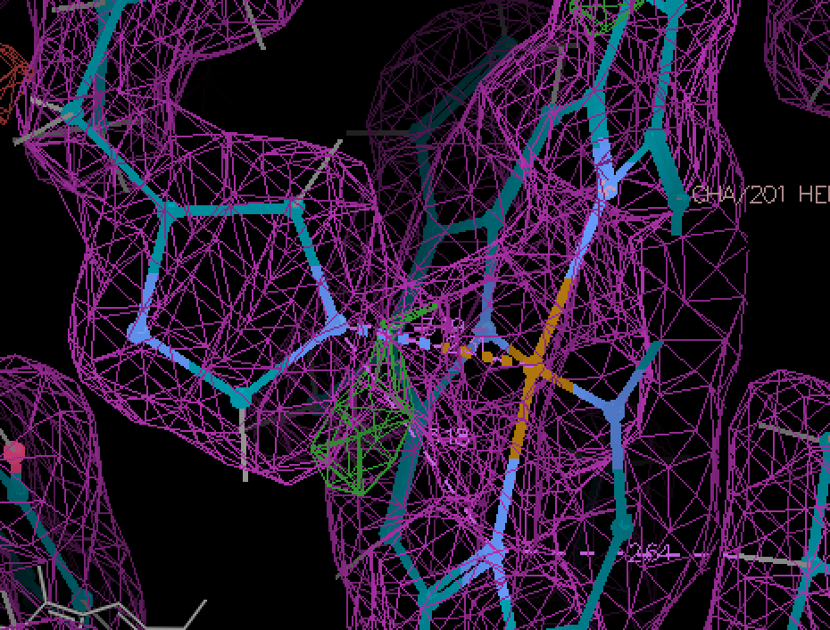
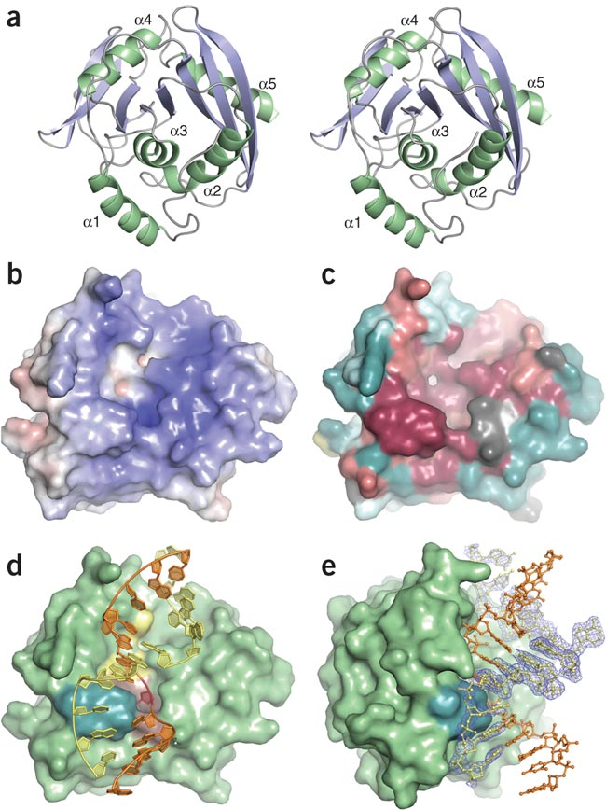
Structural Science and Disabilities
Andrew J Howard, Illinois Tech
ACA Annual Meeting, Summer 2025
Can everyone in your research group understand these illustrations?
It’s a truism that individuals with disabilities can overcome them to make their mark on science. Let’s think about barriers that physical disabilities can impose on structural scientists.
Disability | Limitations to Civic Life | Limitations to executing science | Limitations to communicating science
Deafness | Variable | Modest | Considerable
Blindness | Considerable | Considerable | Tractable
Limitations of Movement | Considerable | Tractable | Modest
Tremors | Variable | Considerable | Modest
Color blindness | Modest | Modest | Considerable
Neurodivergence | Variable | Modest | Variable
When you describe your science, can you reach out to those with disabilities?
Do your posters and slide decks pass Microsoft’s accessibility checks?
Do you avoid color codes that depend on subtle color differences (magenta vs red, gold vs yellow, dark purple vs dark blue)?
Do you depend excessively on cross-eyed stereo to communicate in 3-D?
Have you chosen fonts that most viewers can readily read?
Is your language free of phrases that might be triggers for some neurodivergent individuals?
* It’s a matter of debate whether neurodivergence constitutes a disability; I include it here because it raises some of the same issues as the other categories listed here.
In your lab, how can you facilitate progress by researchers with disabilities?
Are benches at optimal heights?
Are reagents and samples accessible?
Are you relying on color-coding unnecessarily?
Are there provisions for privacy and for sharing?
Can lab members substitute for their colleagues’ limitations?

