Slide 1
Biological Small Angle Solution Scattering
Jesse Hopkins, PhD
IIT/CSRRI
Staff Scientist, BioCAT
Sector 18, Advanced Photon Source

Slide 2
Overview
What is SAXS
Some basic theory
Some basic practice
Standard analysis techniques
SAXS at BioCAT

Slide 3
What is small angle scattering?
Scattering of X-rays (SAXS) or neutrons (SANS) at small angles
Many variations
  Bulk
    Volume properties
  Grazing incidence
    Surface properties
  Biological
  Material

Slide 4
What is biological solution SAXS?
Biophysical technique for studying isolated macromolecules in solution
Complementary to high-resolution structural techniques
  Diffraction
  NMR
  Electron Microscopy

Slide 5
What do solution SAXS?
Studies molecules in solution
  No crystals or labels needed
Wide range of buffer conditions accessible
  Salt, pH, ligand concentration . . .
Study mixtures, complexes, flexibility, disorder
Beamlines and software analysis accessible to non-experts

Slide 6
What can you study with SAXS?
Purity (monodispersity)
Oligomeric State
Shape, size, and anisometry
Flexiblity and disorder
Foldedness
Conformation
Complexes and complex formation
Interparticle interactions

Slide 7
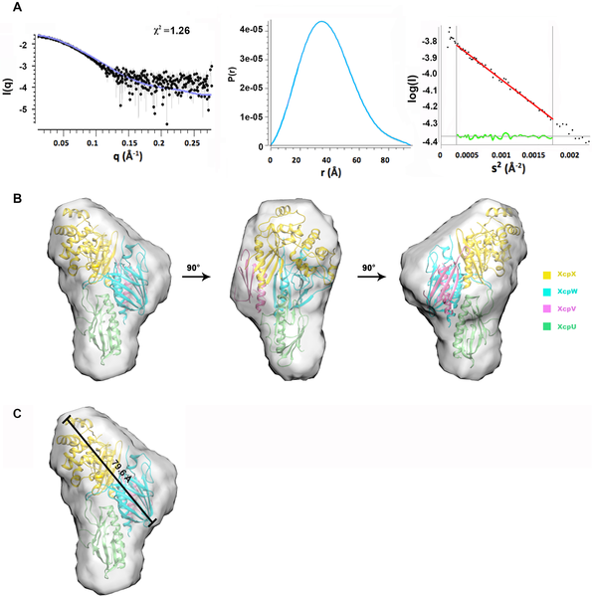
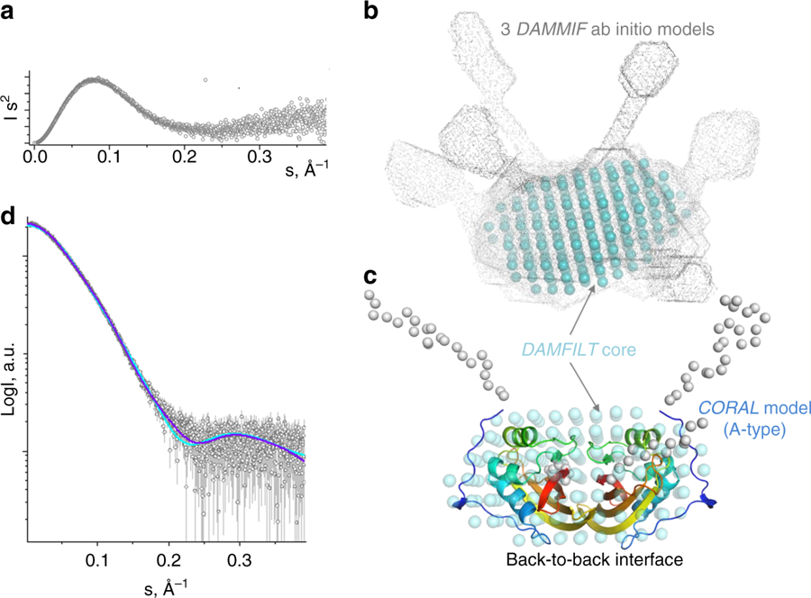
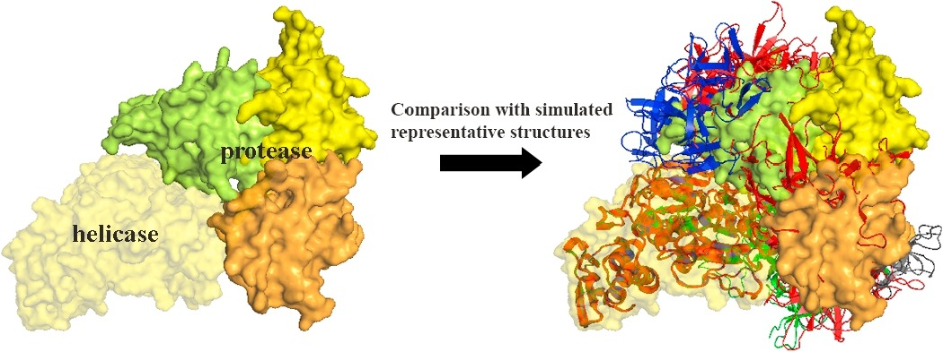
Recent Examples of SAXS in the literature
Check structural similarity between two mutants and a wild type protein
Build homology models constrained by SAXS data
Dock high resolution structures of subunits into the full complex
Validate high resolution structures
Confirm and quantify flexibility predicted by secondary structure analysis
Study solution ensembles of flexible proteins with MD constrained by SAXS
Study conformational changes upon ligand binding, and compare with high resolution structures
Validation between competing NMR and crystallographic structures
Study changes in RNA conformation and flexibility with varying ionic conditions
Test which of the possible crystallographic dimer conformations exist in solution
Validate structural ensembles of open and closed states measured by cryoEM
Constrain computational docking of proteins
Time resolved monitoring of conformational transitions in a DNA origami switch
G. Zhu et al (2018), Progress in Biophysics and Molecular Biology, Advanced Online publication.
D. Harris et al. Nat. Commun. Biol 2018 (1) 125.
Zhang Y, et al. (2018) PLOS Pathogens 14(10): e1007343. https://doi.org/10.1371/journal.ppat.1007343

Slide 8
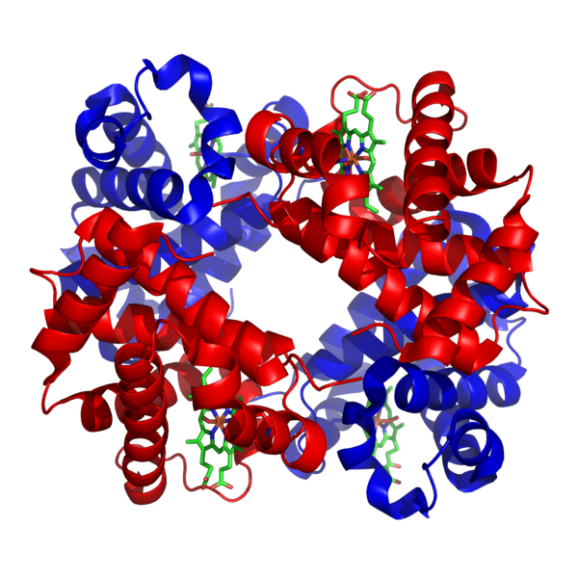
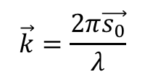


Scattering from a single molecule
$$\vec{r}$$
Incident plane wave
$$e^{i\vec{k}∙\vec{d}}$$
$$\vec{k}=\frac{2π\vec{s_{0}}}{λ}$$
where
is the wavevector
Scattered from electrons separated by a distance $\vec{r}$
Images from Richard Gillilan’s BioSAXS Essentials presentation

Slide 9

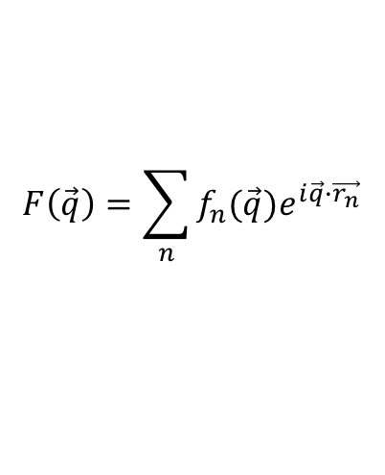
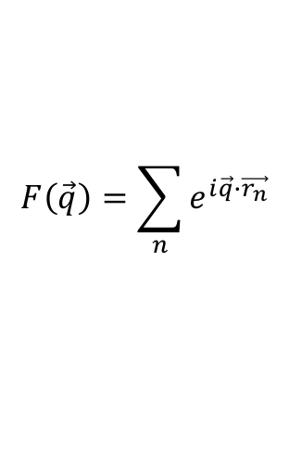
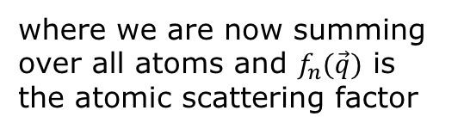
Scattering from a single molecule
The scattering amplitude at any point is the sum over all of the electrons
$$F\left(\vec{q}\right)=\sum_{n}{e^{i\vec{q}∙\vec{r_{n}}}}$$
$$\vec{r}$$
where
$$\vec{q}=\vec{k′}−\vec{k}$$
We define the molecular form factor
$$F\left(\vec{q}\right)=\sum_{n}{f_{n}(\vec{q})e^{i\vec{q}∙\vec{r_{n}}}}$$
where we are now summing over all atoms and $f_{n}(\vec{q})$ is the atomic scattering factor
The wave scatters with a new wavevector $\vec{k′}$
Images from Richard Gillilan’s BioSAXS Essentials presentation

Slide 10
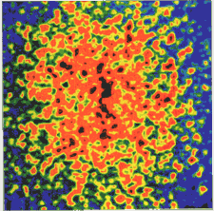
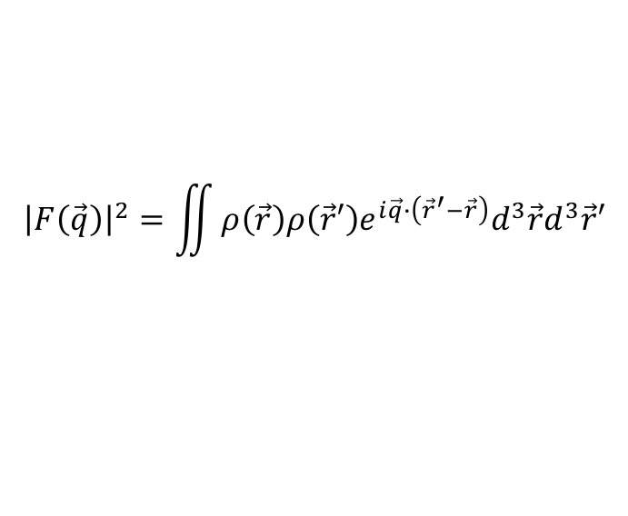

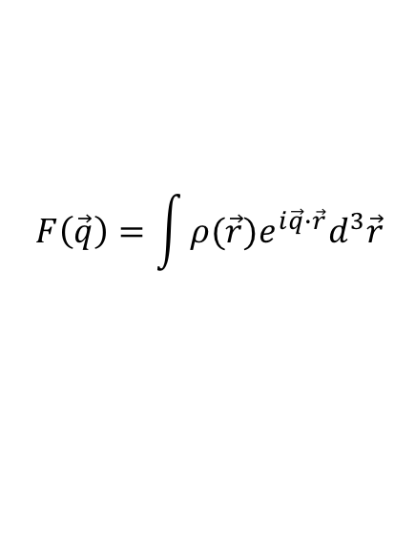
Scattering from a single molecule
$$\vec{r}$$
Defining an electron density $ρ\left(\vec{r}\right)$ gives
$$F\left(\vec{q}\right)=\int{{ρ(\vec{r})e}^{i\vec{q}∙\vec{r}}d^{3}\vec{r}}$$
We measure intensity, not amplitude
Scattering amplitude is the Fourier transform of the electron density!
$${\left|F\left(\vec{q}\right)\right|}^{2}=\iint{ρ\left(\vec{r}\right){ρ\left(\vec{r}′\right)e}^{i\vec{q}∙\left({\vec{r}}^{′}−\vec{r}\right)}d^{3}\vec{r}d^{3}\vec{r}′}$$
Images from Richard Gillilan’s BioSAXS Essentials presentation

Slide 11

Scattering from a single molecule
$$\vec{r}$$
$$2θ_{0}$$
Images from Richard Gillilan’s BioSAXS Essentials presentation

Slide 12
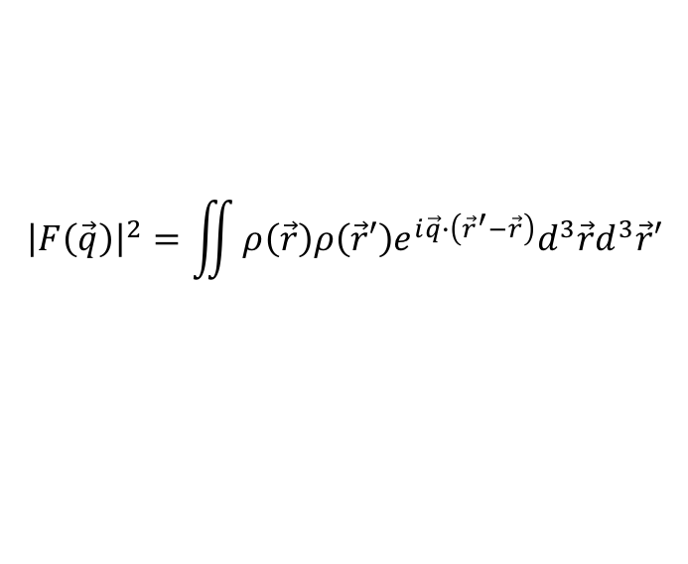

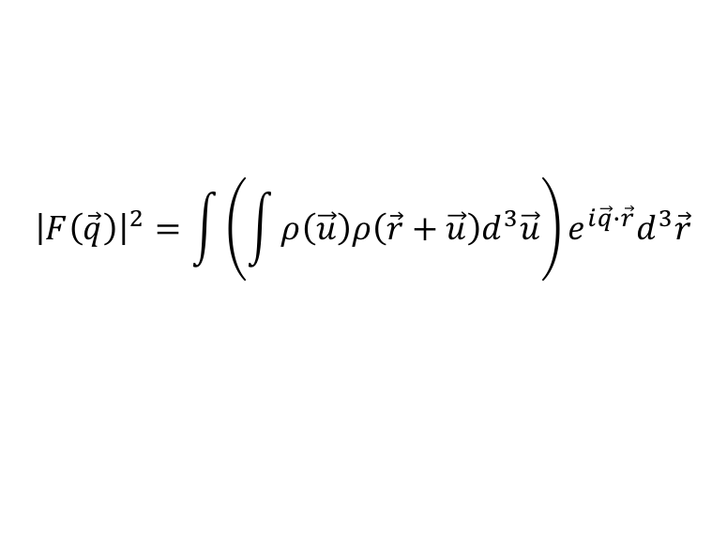
Scattering from a single molecule
out of phase waves cancel
in phase
$$\vec{r}$$
$$2θ_{0}$$
Incoming plane waves
Difference in path length = phase shift
Waves scattered from different parts of the molecule result in phase shifts – a speckled intensity pattern on detector
$${\left|F\left(\vec{q}\right)\right|}^{2}=\iint{ρ\left(\vec{r}\right){ρ\left(\vec{r}′\right)e}^{i\vec{q}∙\left({\vec{r}}^{′}−\vec{r}\right)}d^{3}\vec{r}d^{3}\vec{r}′}$$
Far-field diffraction pattern
change variables: $\vec{u}={\vec{r}}^{′}−\vec{r}$ and swap $\vec{u}$ and $\vec{r}$
$${\left|F\left(\vec{q}\right)\right|}^{2}=\int{\left(\int{ρ\left(\vec{u}\right)ρ\left(\vec{r}+\vec{u}\right)d^{3}\vec{u}}\right)e^{i\vec{q}∙\vec{r}}d^{3}\vec{r}}$$
Images from Richard Gillilan’s BioSAXS Essentials presentation

Slide 13
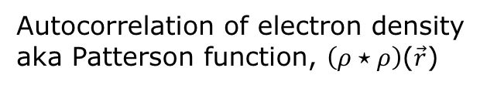
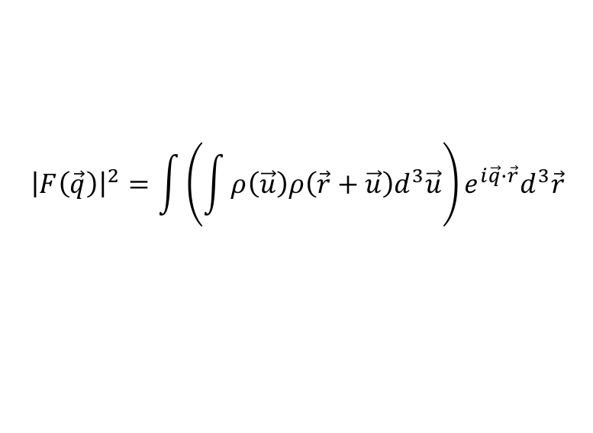
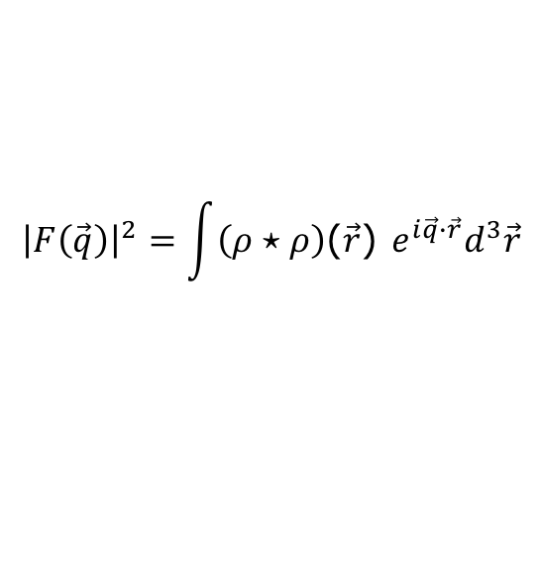
Scattering from a single molecule
out of phase waves cancel
in phase
$$\vec{r}$$
$$2θ_{0}$$
Incoming plane waves
Difference in path length = phase shift
$${\left|F\left(\vec{q}\right)\right|}^{2}=\int{\left(\int{ρ\left(\vec{u}\right)ρ\left(\vec{r}+\vec{u}\right)d^{3}\vec{u}}\right)e^{i\vec{q}∙\vec{r}}d^{3}\vec{r}}$$
Autocorrelation of electron density
aka Patterson function, $\left(ρ⋆ρ\right)$($\vec{r}$)
$${\left|F\left(\vec{q}\right)\right|}^{2}=\int{\left(ρ⋆ρ\right)\text{(}\vec{r}\text{) }e^{i\vec{q}∙\vec{r}}d^{3}\vec{r}}$$
So the intensity is the Fourier transform of the density autocorrelation!
Images from Richard Gillilan’s BioSAXS Essentials presentation

Slide 14
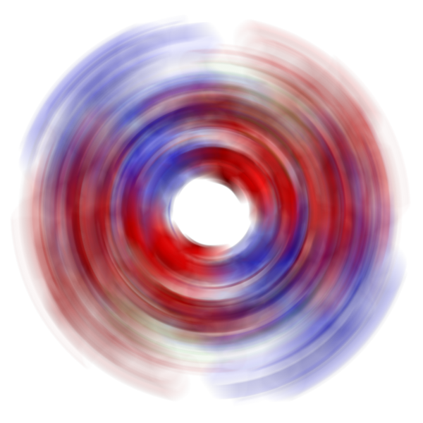
Scattering from molecules in solution
out of phase waves cancel
in phase
$$\vec{r}$$
$$2θ_{0}$$
Incoming plane waves
Difference in path length = phase shift
Since molecules are far apart in dilute solutions, the idealized scattering pattern of the solution is the same as the scattering pattern for a single rotationally-averaged molecule.
Far-field diffraction pattern
Images from Richard Gillilan’s BioSAXS Essentials presentation

Slide 15

The scattering profile
q
$$2θ$$
sample
D (sample-to-detector distance)
Intensity
The scattering profile is the intensity as a function of “q”, the special reciprocal space coordinate that is proportional scattering angle at small angles. I(q)
q
ϕ
I(q) is obtained by integrating around the circle. For detectors, the standard deviation of signal σ(q) is also calculated.
Slide from Richard Gillilan’s BioSAXS Essentials presentation

Slide 16
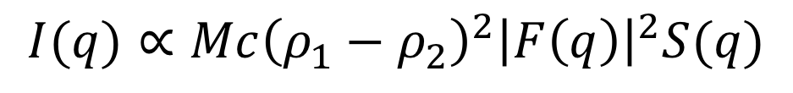
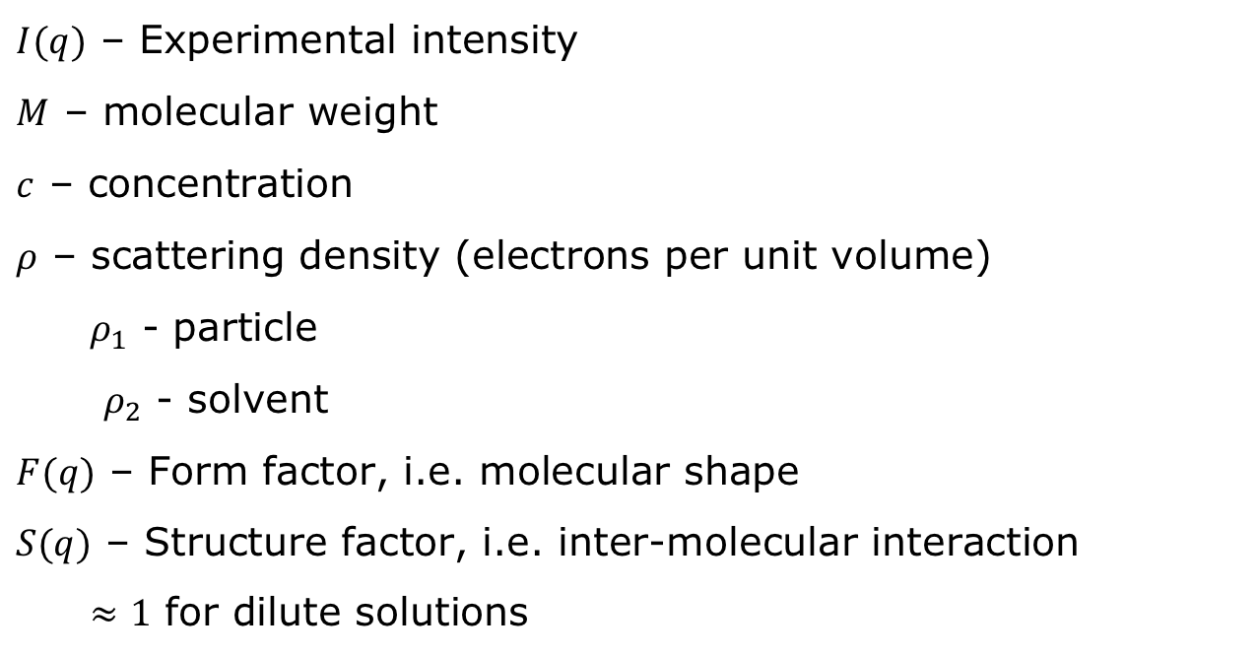
The scattering profile
$$I(q)∝Mc{\left(ρ_{1}−ρ_{2}\right)}^{2}{\left|F\left(q\right)\right|}^{2}S(q)$$
$I(q)$ – Experimental intensity
$M$ – molecular weight
$c$ – concentration
$ρ$ – scattering density (electrons per unit volume)
$ρ_{1}$ - particle
$ρ_{2}$ - solvent
$F(q)$ – Form factor, i.e. molecular shape
$S(q)$ – Structure factor, i.e. inter-molecular interaction
$≈1$ for dilute solutions

Slide 17
Interparticle Interactions
Image from a talk by Thomas Grant

Slide 18
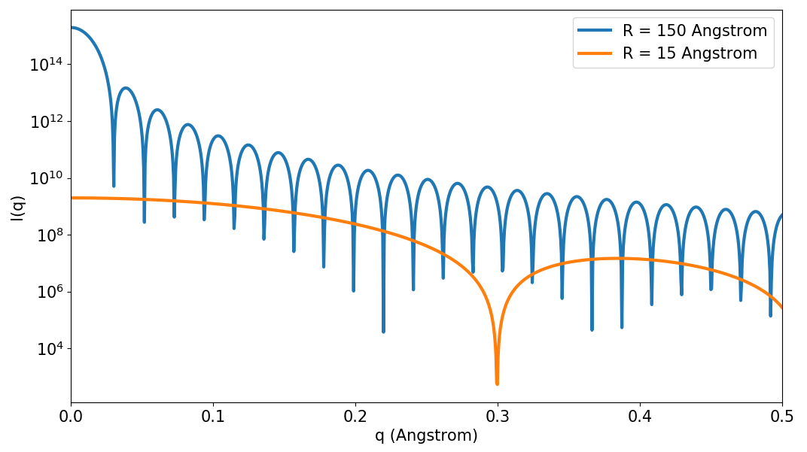
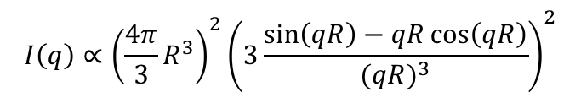
Scattering from a sphere
Scattering from a uniform density sphere with radius R:
$$I\left(q\right)∝{{\left(\frac{4π}{3}R^{3}\right)}^{2}\left(3\frac{\sin\left(qR\right)−qR\cos\left(qR\right)}{{(qR)}^{3}}\right)}^{2}$$
q (Å⁻¹)

Slide 19
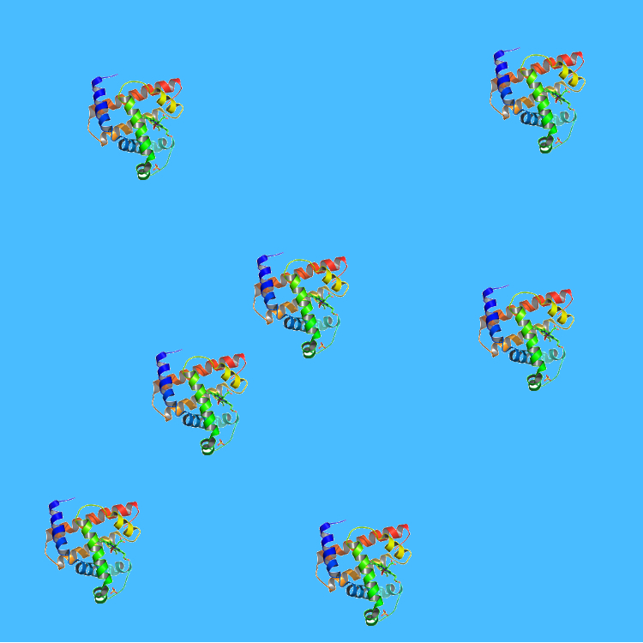

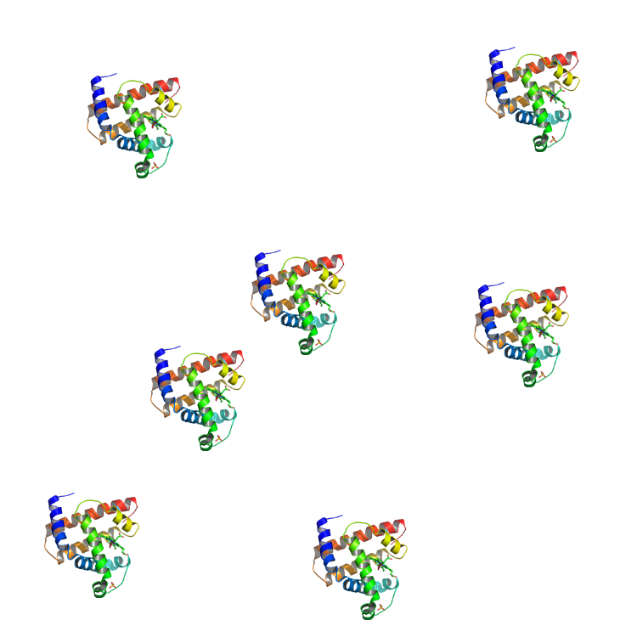
A typical SAXS experiment
2θ
Source
Sample
Beamstop
Detector
Protein Solution
Buffer
Protein
-
=
Intensity
Intensity
q

Slide 20
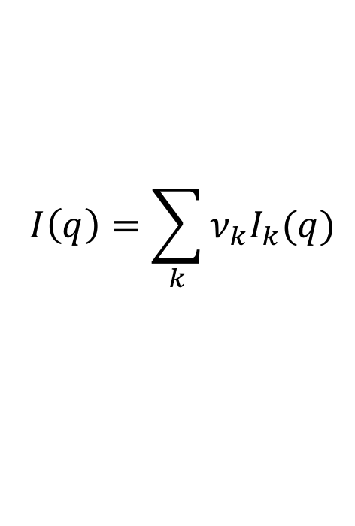
Sample preparation for SAXS
The single most important part of a SAXS experiment is the sample prep!
The scattering from a mixture is a volume-fraction weighted average of the individual components
$$I\left(q\right)=\sum_{k}{ν_{k}I_{k}(q)}$$
As scattering depends on molecular weight, even small amounts of larger multimers or aggregates can significantly impact your measurement

Slide 21
Sample preparation for SAXS
Most common sample quality issues:
Polydisperse sample
  Aggregates, multimers of the same molecule, other heterogeneities
  Multiple conformations in solution affect scattering, must be treated carefully
Concentration effects
  Interparticle interaction or repulsion
Improper buffer match
  The buffer measurement and the sample buffer must be perfectly matched (e.g by dialysis)
Radiation damage

Slide 22
Sample preparation for SAXS
Use complementary biophysical techniques before coming to the beamline to ensure sample quality
  SDS-PAGE gels and native gels
    Necessary, but not sufficient
  Symmetric single peaks by size exclusion chromatography (SEC)
  No visible particulate or precipitate in solution
  Dynamic light scattering
  SEC-MALS
  Sedimentation Velocity
  Sedimentation Equilibrium
  Etc . . .

Slide 23
Sample preparation for SAXS
Think about what your sample will look like at the beamline:
How well does it store at 4° C and/or -80° C?
How can you transport it?
  If shipping, will it survive shipping, and if so at what temperature
Optimize buffer conditions for storage and transport, as well as scattering
Are there concentration dependent effects (oligomerization, aggregation, etc) that limit what concentrations you can use?

Slide 24
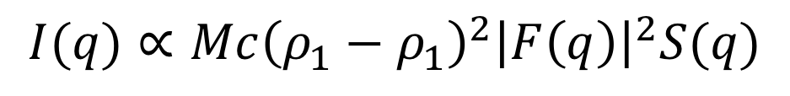
Sample preparation for SAXS
$$I(q)∝Mc{\left(ρ_{1}−ρ_{1}\right)}^{2}{\left|F\left(q\right)\right|}^{2}S(q)$$
Optimal sample concentration:
  Scattering intensity depends on molecular mass and concentration
  Useful rule of thumb:
    MM (kDa) * C (mg/ml) ~ 60
  Most beamlines use ~20-50 uL of sample for a single ‘batch’ measurement
  Must do a dilution series around target concentration
    Demonstrates no concentration effects in data
    At least a factor of 2 increase and decrease in the concentrations
  Example: Lysozyme (14.3 kDa)
    Target concentration: ~60/14.3 = 4.2 mg/ml
    Concentration series: 8.0, 4.0, 2.0 mg/ml (at least)

Slide 25
Sample preparation for SAXS
Buffer considerations:
Bring lots of matched buffer
Most buffers are fine for SAXS (Tris, HEPES, PBS, etc…)
Moderate salt concentrations, < 1M NaCl
1-2% glycerol can prevent radiation damage (keep <5%)
Avoid detergents if possible, keep below CMC if you need them
Small amounts (1 mM) of fresh DDT, TCEP, BME, or other reducing agents can prevent radiation damage

Slide 26
Sample preparation for SAXS
Buffer matching:
Dialysis – best
SEC flow through buffer - good
  Must be from last purification step
Concentrator flow through buffer – okay
  Only use this if you don’t have the other options
  Can be useful at the beamline for quickly changing buffers
Don’t make matches by hand!

Slide 27
Data collection for SAXS
Talk to beamline scientists before arriving to plan experiments
Spin sample in centrifuge immediately before loading
  Remove dust, very large aggregates
  Don’t pellet your sample!
Do multiple concentrations (batch mode)
Adjust exposure to minimize radiation damage

Slide 28
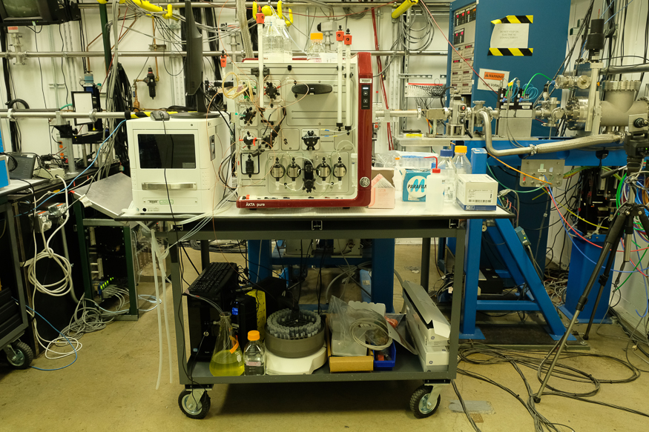
Data collection for SAXS
Batch mode:
  Load buffer/sample into a sample cell
  Flow/oscillate sample in sample cell to minimize radiation damage
  Clean sample cell
  Repeat next buffer/sample
  Recommended pattern:
    Buffer, sample, buffer, buffer, sample, buffer, buffer, sample, etc.
Liquid chromatography SAXS (LC-SAXS):
  Hook output of liquid chromatography column to SAXS cell
  Collect data during entire elution
  Provides separation immediately before data collection

Slide 29
SEC-SAXS
Sample
injection
SEC
column
Detector
Pump
UV
X-rays
Most common LC-SAXS is SEC-SAXS
Separates sample by size just before measurement
  Removing large aggregates
  Complexes where multiple components are also in solution
Almost all SAXS at BioCAT is done with SEC-SAXS

Slide 30
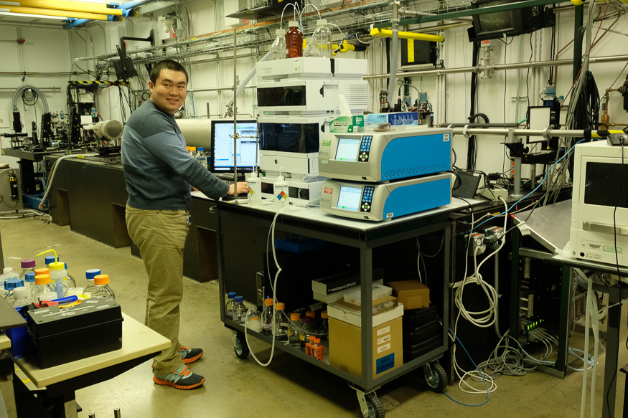
SEC-MALS-SAXS
SEC-SAXS coupled to multi-angle light scattering, dynamic light scattering, and refractive index measurement

Slide 31
So you have a scattering profile . . . now what?
Verify data quality
  Check individual curves for differences (automated)
    Radiation damage
Carry out buffer subtraction
Check macromolecule state, further data quality checks
  Guinier analysis
  MW analysis
  Check for concentration dependence
Simple analysis based on profile
  Kratky plot for flexibility
More advanced analysis
  IFT
  Envelope reconstruction
  Rigid body modeling, ensemble modeling, etc.

Slide 32
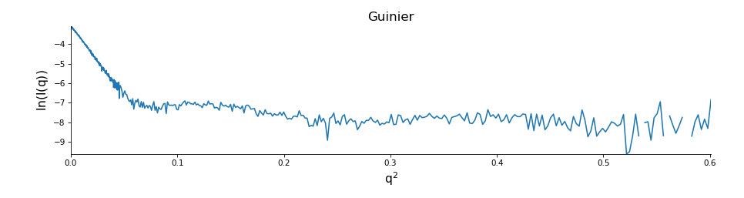
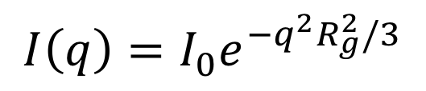
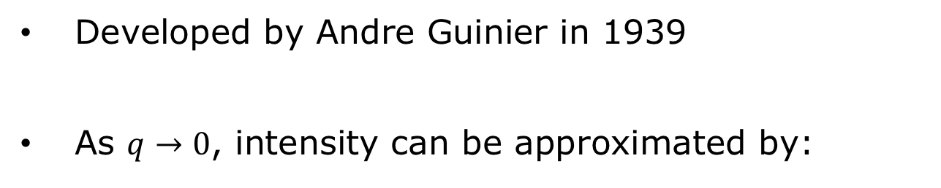
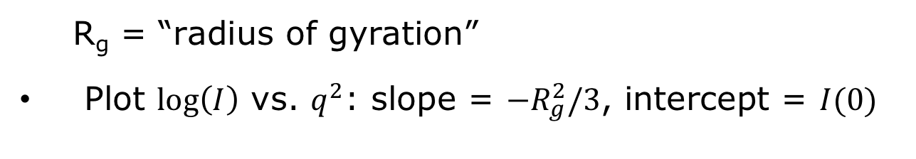
Guinier analysis
Developed by Andre Guinier in 1939
As $q→0$, intensity can be approximated by:
$$I\left(q\right)=I_{0}e^{−q^{2}R_{g}^{2}/3}$$
R_{g} = “radius of gyration”
Plot $\log\left(I\right)$ vs. $q^{2}$: slope = $−R_{g}^{2}/3$, intercept = $I(0)$
Guinier region

Slide 33
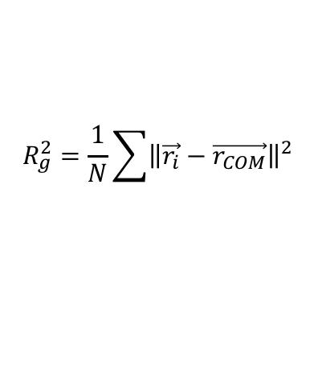
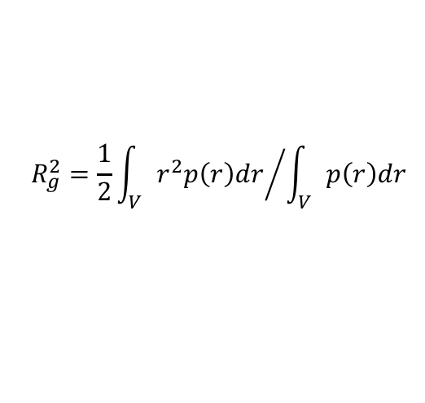
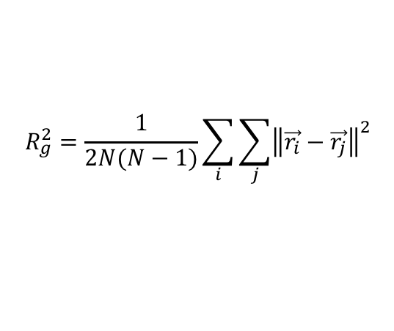
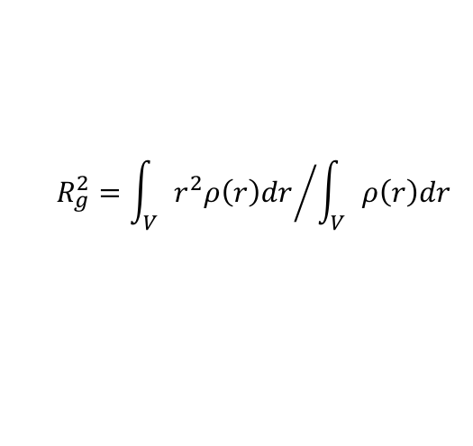
Guinier analysis
Radius of gyration:
  RMS distance from center of mass
Lysozyme
Useful definitions of R_{g}
$$R_{g}^{2}=\frac{1}{N}\sum{{\left\|\vec{r_{i}}−\vec{r_{COM}}\right\|}^{2}}$$
by atoms
R_{H}
45 Å
$$R_{g}^{2}={\int_{V}{r^{2}ρ\left(r\right)dr}}/{\int_{V}{ρ\left(r\right)dr}}$$
by electron
density
R_{g}
R_{M}
$$R_{g}^{2}=\frac{1}{2N(N−1)}\sum_{i}{\sum_{j}{{\left\|\vec{r_{i}}−\vec{r_{j}}\right\|}^{2}}}$$
by atom
pairs
R_{R}
26 Å
$$R_{g}^{2}={\frac{1}{2}\int_{V}{r^{2}p\left(r\right)dr}}/{\int_{V}{p\left(r\right)dr}}$$
R_{g} – radius of gyration
R_{H} – hydrodynamic radius
R_{M} – radius of mass-equivalent sphere
R_{R} – maximum hard sphere radius
by pair
distribution
Image from:
www.silver-colloids.com/Papers/hydrodynamic-radius.pdf

Slide 34
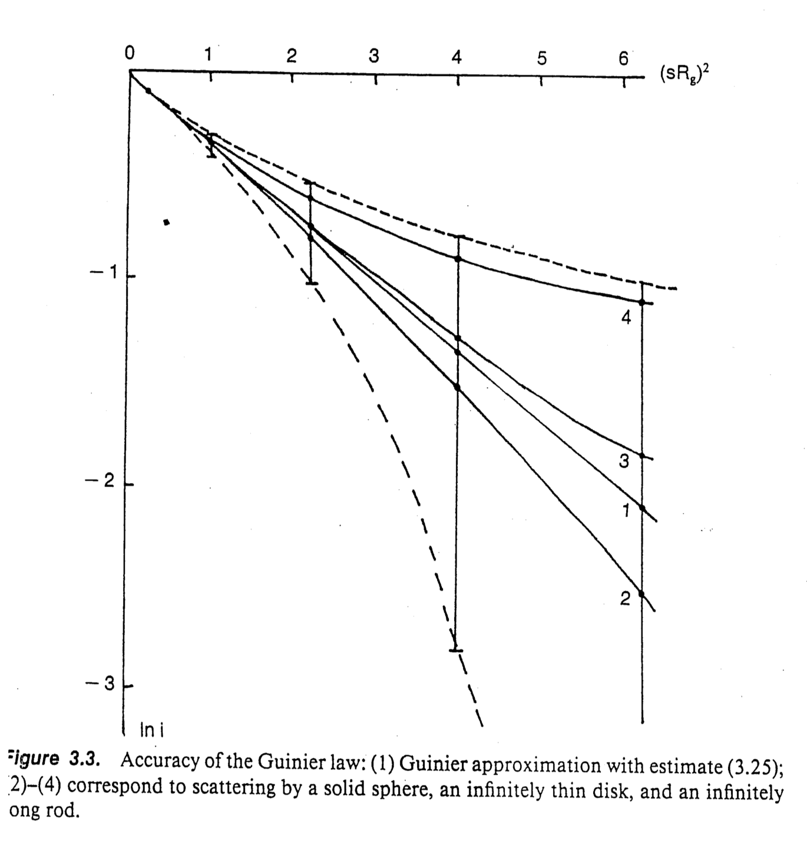



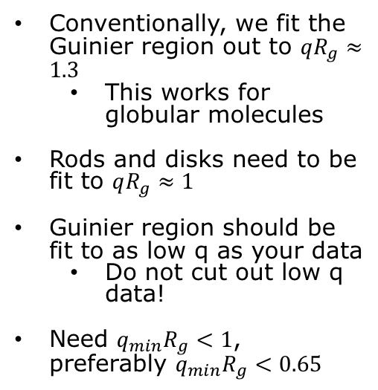

Guinier analysis
The Guinier approximate is only approximate at low q. How do you pick you fit endpoints?
  It depends on particle shape and size!
$$I\left(q\right)=I_{0}e^{−q^{2}R_{g}^{2}/3}$$
$$qR_{g}=1.0$$
$$qR_{g}=1.3$$
Need $qR_{g}$ sufficiently small that this approximate holds
Conventionally, we fit the Guinier region out to $qR_{g}≈1.3$
  This works for globular molecules
Rods and disks need to be fit to $qR_{g}≈1$
Guinier region should be fit to as low q as your data
  Do not cut out low q data!
Need ${q_{min}R}_{g}<1$, preferably ${q_{min}R}_{g}<0.65$
Rod
Disk
Guinier approx.
Sphere

Slide 35
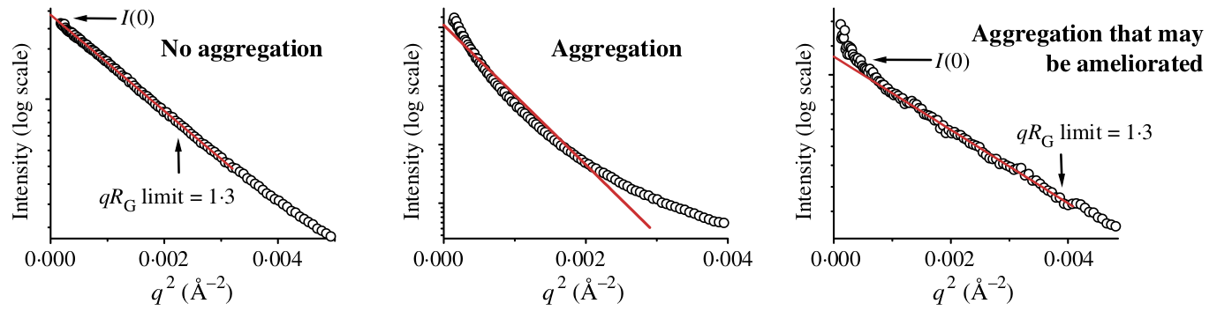
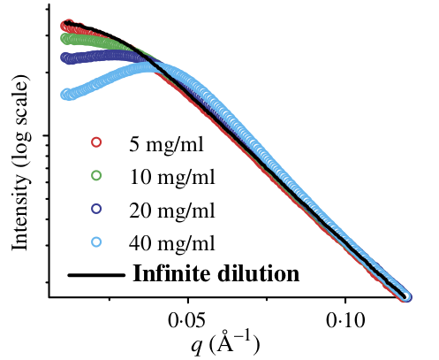
Guinier analysis
Non-linearities in Guinier analysis are indicative of problems with your sample
Aggregation causes a characteristic upturn at low q
  Could be caused by aggregates in the sample, or by radiation induced aggregation (radiation damage
Downturns at low q are characteristic of structure factor, also show up in a Guinier fit
Images from Putnam et al. Quarterly reviews of biophysics, 40(3) 2007.

Slide 36
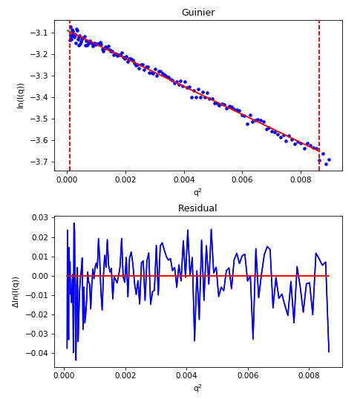
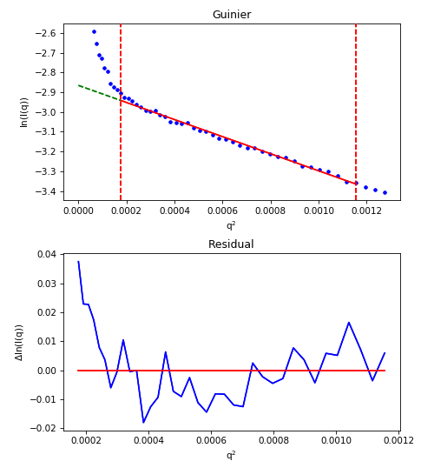
Guinier analysis
Fit residual can help you see problems
Aggregated
Monodisperse

Slide 37
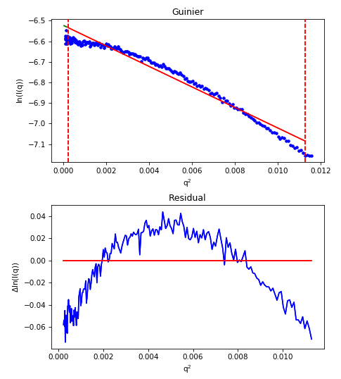
Guinier analysis
Fit residual can help you see problems
Repulsive
(structure factor)
Monodisperse

Slide 38
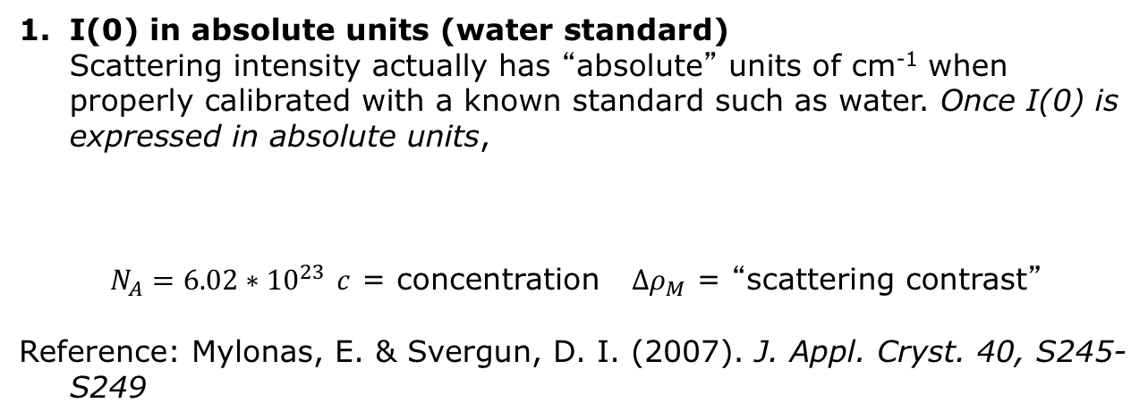
Molecular weight from SAXS
Molecular weight estimates from SAXS are ~10% accurate at best. Despite this, it is important to estimate MW to verify it matches what you expect
I(0) in absolute units (water standard)
Scattering intensity actually has “absolute” units of cm⁻¹ when properly calibrated with a known standard such as water. Once I(0) is expressed in absolute units,
$N_{A}=6.02∗{10}^{23}$ $c$ = concentration $Δρ_{M}$ = “scattering contrast”
Reference: Mylonas, E. & Svergun, D. I. (2007). J. Appl. Cryst. 40, S245-S249

Slide 39
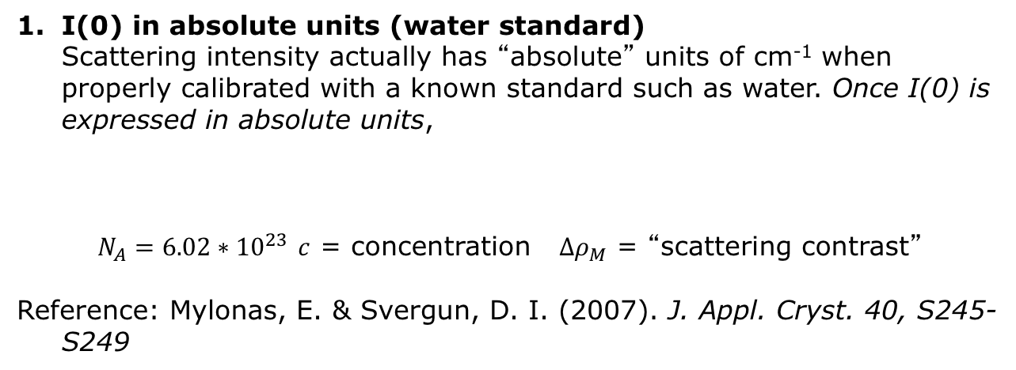
Molecular weight from SAXS
I(0) in absolute units (water standard)
Scattering intensity actually has “absolute” units of cm⁻¹ when properly calibrated with a known standard such as water. Once I(0) is expressed in absolute units,
$N_{A}=6.02∗{10}^{23}$ $c$ = concentration $Δρ_{M}$ = “scattering contrast”
Reference: Mylonas, E. & Svergun, D. I. (2007). J. Appl. Cryst. 40, S245-S249
2. Protein standards
Unknown molecular weights can be determined by comparison with known protein standards such as lysozyme or glucose isomerase:
Reference: Mylonas, E. & Svergun, D. I. (2007). J. Appl. Cryst. 40, S245-S249

Slide 40
Molecular weight from SAXS
I(0) in absolute units (water standard)
Scattering intensity actually has “absolute” units of cm⁻¹ when properly calibrated with a known standard such as water. Once I(0) is expressed in absolute units,
$N_{A}=6.02∗{10}^{23}$ $c$ = concentration $Δρ_{M}$ = “scattering contrast”
Reference: Mylonas, E. & Svergun, D. I. (2007). J. Appl. Cryst. 40, S245-S249
Both of these methods require accurate concentration measurements!
2. Protein standards
Unknown molecular weights can be determined by comparison with known protein standards such as lysozyme or glucose isomerase:
Reference: Mylonas, E. & Svergun, D. I. (2007). J. Appl. Cryst. 40, S245-S249

Slide 41
Molecular weight from SAXS
3. Porod volume and relative scale methods
Mass (in kDa) can calculated as the density times the volume of the particle. The Porod volume of the particle is used, and is calculated:
The density used is typically 0.83*10⁻³ kDa/Å³, but can be adjusted for the particular application.
More advanced techniques based on this idea can give quite accurate
Reference: Fischer et al. (2009). J. Appl. Cryst., 43, 101-109

Slide 42
Molecular weight from SAXS
3. Porod volume and relative scale methods
Mass (in kDa) can calculated as the density times the volume of the particle. The Porod volume of the particle is used, and is calculated:
The density used is typically 0.83*10⁻³ kDa/Å³, but can be adjusted for the particular application.
More advanced techniques based on this idea can give quite accurate
Reference: Fischer et al. (2009). J. Appl. Cryst., 43, 101-109
4. Volume of correlation method
Molecular weight can be estimated using the empirically relation:
The values of k and c depend on the type of macromolecule. For proteins k = 1 and c = 0.1231, for RNA k = 0.808 and c = 0.00934.
Reference: Rambo and Tainer (2013). Nature, 496, 477-481
where
and

Slide 43
Molecular weight from SAXS
3. Porod volume and relative scale methods
Mass (in kDa) can calculated as the density times the volume of the particle. The Porod volume of the particle is used, and is calculated:
The density used is typically 0.83*10⁻³ kDa/Å³, but can be adjusted for the particular application.
More advanced techniques based on this idea can give quite accurate
Reference: Fischer et al. (2009). J. Appl. Cryst., 43, 101-109
4. Volume of correlation method
Molecular weight can be estimated using the empirically relation:
The values of k and c depend on the type of macromolecule. For proteins k = 1 and c = 0.1231, for RNA k = 0.808 and c = 0.00934.
Reference: Rambo and Tainer (2013). Nature, 496, 477-481
Both of these methods do not rely on the concentration of the sample, making them useful as checks for methods 1 and 2, and in cases where the concentration may not be known (such as SEC-SAXS).
where
and

Slide 44
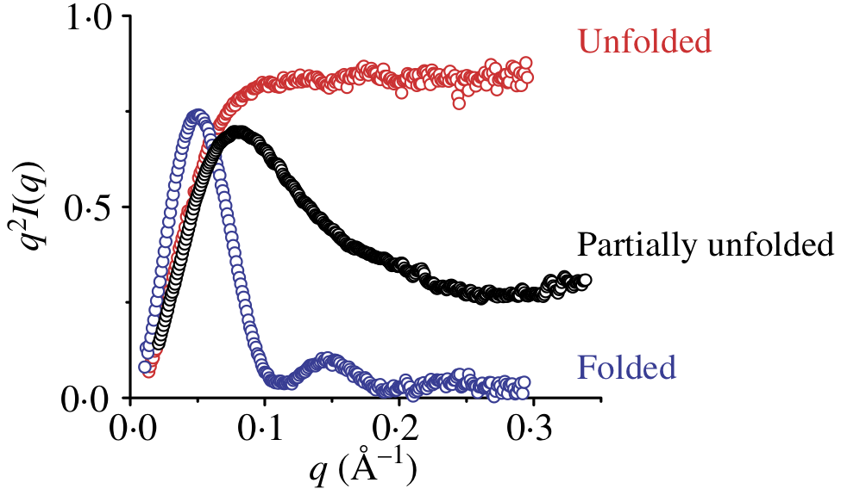


Further analysis of the scattering profile
Several other methods exist for analyzing the scattering profile
Kratky and Porod plots inform on shape and flexibility
Kratky plot: $q^{2}I\left(q\right)$ vs $q$
Porod plot: $q^{4}I\left(q\right)$ vs $q$
Normalized versions of the Kratky plot can give semi-quantitative information about flexibility
Image from Putnam et al. Quarterly reviews of biophysics, 40(3) 2007.

Slide 45
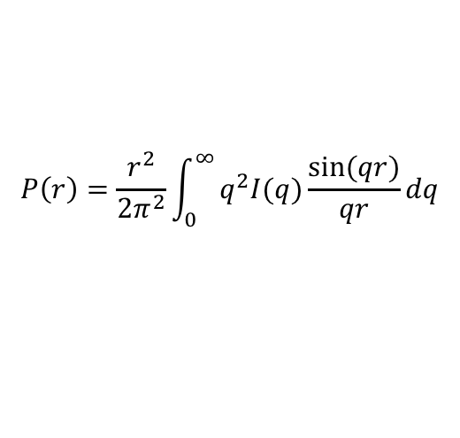
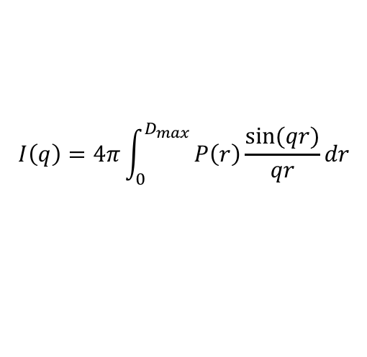
Indirect Fourier Transform (IFT)
So the scattering profile is the Fourier transform of the electron density. Can we just Fourier transform it back to get the molecular shape?
No.
  The scattering profile is a radial average of the intensities or a rotationally averaged molecule
  We’ve lost too much information, including phases (which is also an issue in crystallography)
However . . .
We can do an Indirect Fourier Transform (IFT) and get the pair distance distribution function, P(r)
$$I\left(q\right)=4π\int_{0}^{D_{max}}{P\left(r\right)\frac{sin⁡(qr)}{qr}dr}$$
$$P\left(r\right)=\frac{r^{2}}{2π^{2}}\int_{0}^{∞}{q^{2}I(q)\frac{sin⁡(qr)}{qr}dq}$$

Slide 46
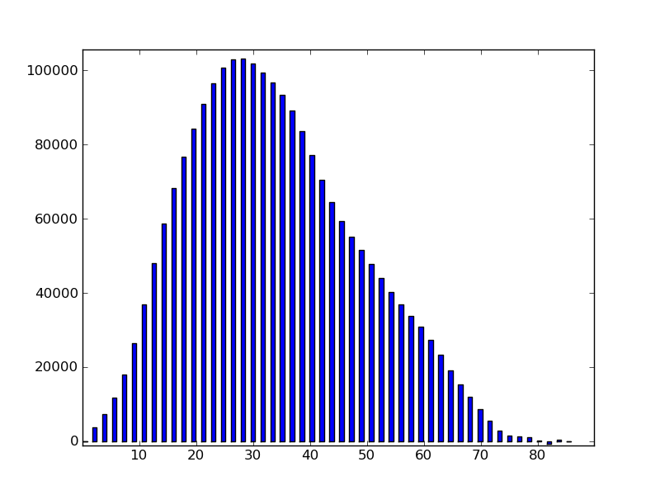
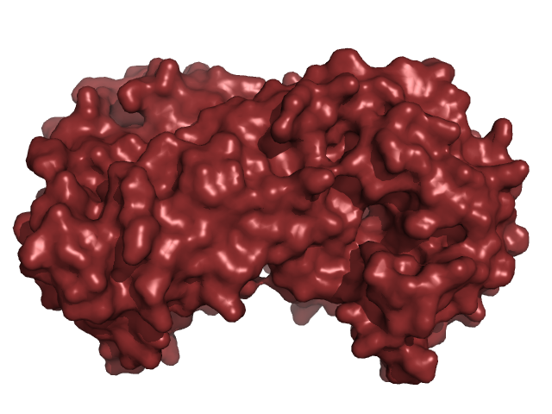
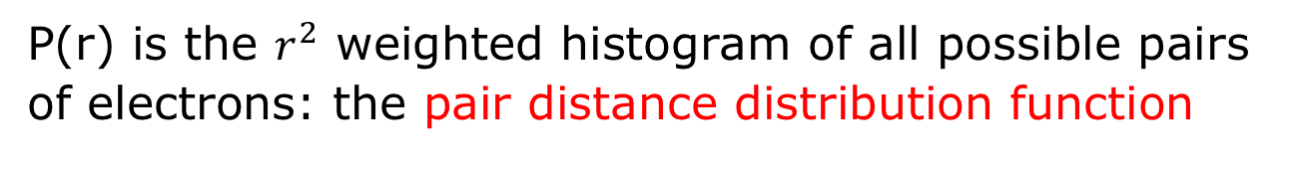
Physical interpretation of P(r)
P(r) is the $r^{2}$ weighted histogram of all possible pairs of electrons: the pair distance distribution function
shoulder due to pair of domains
R² weighted frequency of occurrence
1TIM.pdb
distance between points
D_{max} maximum dimension of object
Images from Richard Gillilan’s BioSAXS Essentials talk

Slide 47


Physical interpretation of P(r)
The shape of the P(r) function can tell you a lot about the shape of your particle
4
Solid sphere
3
P(r)
Rod
2
Disc
1
Hollow sphere
0
r, nm
0
2
4
6
8
10
Dumbbell
Images from Svergun & Koch, Reports on the progress of physics, 66, 2003.

Slide 48
Physical interpretation of P(r)
The shape of the P(r) function can tell you a lot about the shape of your particle
Image from Putnam et al. Quarterly reviews of biophysics, 40(3) 2007.

Slide 49



Physical interpretation of P(r)
The P(r) function can be used to calculate the $R_{g}$ and $I\left(0\right)$ values of the curve.
  Uses entire curve
  Less sensitive to interparticle interactions
  Less sensitive to aggregates
  Automatic extrapolation to $q=0$
  Especially useful for large particles with small Guinier regions and for noisy data
  Good check against Guinier analysis
$$R_{g}^{2}=\frac{\int_{0}^{D_{max}}{r^{2}P\left(r\right)dr}}{2\int_{0}^{D_{max}}{P\left(r\right)dr}}$$
$$I\left(0\right)=4π\int_{0}^{D_{max}}{P\left(r\right)dr}$$

Slide 50


How to calculate a P(r) function
Why can’t you directly do a Fourier transform (why the I in IFT)?
$$P\left(r\right)=\frac{r^{2}}{2π^{2}}\int_{0}^{∞}{q^{2}I(q)\frac{sin⁡(qr)}{qr}dq}$$
The finite extent of our measurement (and measurement noise) means that a direct Fourier transform distorts the true P(r) function. You get ‘truncation artifacts’.
You generate a P(r) with a given $D_{max}$ by fitting against the data
  Fitting criteria include both ‘fit’ ($χ^{2}$) and ‘regularization’ parameters
  Regularization include ‘perceptual’ criteria such as
    Smoothness of the P(r)
    Systematic deviations from I(q)
    Stability of the solution when changing parameter weighting
    Positivity of the solution

Slide 51


How to calculate a P(r) function
Most commonly we use a program called GNOM to do the IFT, though others exist.
Requires estimate of $D_{max}$ for IFT
Criteria for judging a good $D_{max}$ based on P(r) function:
P(r) falls gradually to zero at $D_{max}$
Underestimated $D_{max}$ has an abrupt descent
Overestimated $D_{max}$ usually shows oscillation about zero
Additional P(r) criteria:
$R_{g}$ and $I(0)$ from Guinier and P(r) should agree well
P(r) goes to zero at $r=0$ and $r=D_{max}$
Even for good data, uncertainty in determining $D_{max}$ can be 10%

Slide 52


How to calculate a P(r) function
IFT

Slide 53


3D shape reconstruction
Can we ab initio reconstruct 3D shapes from SAXS?
No. And Yes.
SAXS doesn’t provide a unique solution, but it can provide a solution.
Too much information is lost in the 1D intensity to uniquely recover a 3D shape
The most common reconstructions are dummy atom (‘bead’) models
Polymerase
Lysozyme

Slide 54

3D shape reconstruction
Most common program is DAMMIF/N
Basic idea:
  Generate a volume of dummy atoms (DAMs, aka ‘beads’) and randomly assign beads to be solvent or molecule
  Calculate the fit against the data
  Flip some of the beads from solvent to molecule or vice versa, recalculate fit against data
  Accept if the fit is better, usually reject if the fit is worse
  Repeat until you fit the data
Uses a monte-carlo like approach, as total possible number of models is massive
Uses simulated annealing to avoid local minima
Applies physical constraints to improve models:
  Connectivity
  Compactness
  Size based on $R_{g}$ and $D_{max}$

Slide 55






3D shape reconstruction
Run DAMMIF 20 times, get 20 different answers

Slide 56
3D shape reconstruction
Produce 10-20 ab initio reconstructions
Run an averaging procedure to determine the most probable model, align all to this
Estimate similarity of models using the Normalized Spatial Discrepancy (NSD)
  Average NSD ≈ 0.5 – good stability of reconstructions
  Average NSD ≈ 0.7-0.9 – fair stability of reconstructions
  Average NSD > 1.0 – poor stability of reconstructions
Averaging procedure then produces a ‘most populated volume’
  Best practice, refine a reconstruction fixing this most populated volume

Slide 57
3D shape reconstruction
There is a new electron density reconstruction method ‘DENSS’
Similar to bead modeling, no unique solutions
Unlike bead modeling, can deal with multiple different particle electron densities
  Example: Protein-micelle complex
Reference: T. D. Grant. Nature Methods (2018) volume 15, pages 191–193.
Figure from: Grant, T.D. (2018) Nature Methods

Slide 58

Calculating scattering profiles
Calculating scattering profiles from models is extremely important. Any real space modeling against data requires it.
Calculations must be accurate, and fast, so that thousands (or hunderds of thousands) of models can be tested
Many different algorithms exist for this purpose
Modeling the solvent shell and excluded volume are significant challenges
  Hydration shell is hard to calculate, varies from program to program
Most methods involve calculate scattering based on either the Debye equation or the spherical harmonics approximation.
$$I\left(q\right)=\sum_{i}{\sum_{j}{f_{i}\left(q\right)f_{j}(q)\frac{sin⁡(qr_{ij})}{qr_{ij}}}}$$

Slide 59
Calculating scattering profiles
CRYSOL, FoXS are the most common programs, many exist
Most accurate may be WAXSiS which uses all atom MD simulation to calculate solvation
Table from
Schniedman-Duhovny, et al. (2012) BMC Structural Biology

Slide 60
Other analysis methods
We’ve barely scratched the surface of what you can do with SAXS. Here’s a quick list of some other methods:
Rigid body modeling to refine high resolution structures against SAXS models
Ensemble modeling to model flexible structures in solution
Coupling MD to SAXS to model flexibility
Using SAXS as global/long distance constraints for NMR modeling
Modeling scattering from mixtures, extracting information on individual components
Using SAXS as a constraint for docking models

Slide 61
Other experimental techniques
There are several experimental techniques available to SAXS
Batch mode
  Loading single concentration samples into a measurement cell
LC-SAXS
  Liquid chromatography coupled to SAXS, most commonly size exclusion chromatography
Time resolved SAXS
  Changing sample conditions and watching the time resolved response of your system
Contrast variation SAXS and SANS
  Vary the contrast of the sample/buffer to selectively blank out scatterers and resolve individual subunits
Anomalous SAXS
  Measure above and below an anomalous x-ray edge, and use the difference in scattering to inform on heavy atom distribution in your sample

Slide 62
SAXS at BioCAT
Equilibrium SAXS
  Size exclusion chromatography coupled SAXS (SEC-SAXS)
  Size exclusion chromatography, multi-angle light scattering, dynamic light scattering, refractive index coupled SAXS (SEC-MALS-SAXS)
  Batch mode

Slide 63

SAXS at BioCAT
Non-equilibrium time resolved SAXS
  Continuous flow mixing
    ~100 𝜇s minimum time point
    Flow helps prevent radiation damage
  Stopped flow mixing
    ~1 ms minimum time point
    Established technology
Kathuria et al., 2011, Biopolymers, 95(8)
CF-SAXS developed in close collaboration with Osman Bilsel at U. Mass. Amherst

Slide 64

Example – Equilibrium SAXS with single molecule FRET
SAXS helped in clarifying the auto-regulatory function of the chromodomains in substrate specificity & in the generation of intermediates during nucleosome sliding by the chromatin remodeler CHD1. Qiu et al., The Chd1 Chromatin Remodeler Shifts Nucleosomal DNA Bidirectionally as a Monomer. Mol Cell. 2017 Oct 5;68(1):76-88.e6.
The KAK mutant displays an extended structure and a more stable interaction with double stranded DNA (A) Crystal structure of
the chromodomain-ATPase portion of Chd1, highlighting the location of KAK mutation at the chromo-ATPase interface. (B) Small angle X-ray scattering (SAXS) profiles for Chd1-WT and Chd1-KAK proteins consisting of just the chromodomain and ATPase motor. Guinier plot analysis (inset) shows that samples were free from aggregation. (C) P(R) distributions for SAXS data shown in (B). (D) Ab initio bead models generated by DAMMIN. Cartoons on the right illustrate possible structural changes associated with the KAK mutation. (E) Schematic of experiment in which Cy3 labeled dsDNA (40 or 60 bp) was added to surface immobilized Chd1-WT or Chd1-KAK proteins. Note that these
constructs contain the DBD. (F) Binding duration for dsDNA to both proteins (n=500 binding events).

Slide 65


Example – SAXS with MD
Structures and comparisons of the experimental and simulated scattering profiles. (A) tSA;(B) ASA-IgG2; (C) One ASA-IgG2 and one tSA molecule; (D) One ASA-IgG2 and two tSA molecules; (E) Two ASA-IgG2 and one tSA molecule; (F) Two ASA-IgG2 and two tSA molecules in monodentate configuration; (G) Two ASA-IgG2 and two tSA molecules in bidentate configuration. Blue mesh represents the configurational space samples by the ensembles referenced to one Fc. tSA: tetrameric Streptavidin, ASA-IgG2: Anti Streptavidin – IgG2.
The use of SEC-SAXS and ensemble modeling is the only way to characterize antibody–antigen complexes using SAXS. Castellanos et al., Antibodies 2017 6(4), 25.

Slide 66
Resources
Useful references for theory:
Glatter and Kratky, Small Angle X-ray Scattering, 1982.
  The classic text
Svergun, Koch, Timmins. Small Angle X-ray and Neutron Scattering from Solutions of Biological Macromolecules, 2013.
  A modern classic
Meisburger et al., X-ray Scattering Studies of Protein Structural Dynamics. Chemical Reviews 117(12), 2017.
  A good modern review of scattering theory with conventional notation
Svergun and Koch, Small-angle scattering studies of biological macromolecules in solution. Reports on Progress in Physics 66, 2003.
  A good overview of some basic and not-so basic theory. The analysis techniques it refers to are somewhat dated.

Slide 67
Resources
Useful references for application:
Jacques and Trewhella, Small-angle scattering for structural biology – Expanding the frontier while avoiding the pitfalls. Protein Science, 19, 2010.
  An excellent overview of SAXS and a lot of the basic analysis methods and problems. Slightly dated, it doesn’t mention SEC-SAXS for example.
Putnam et al., X-ray solution scattering (SAXS) combined with crystallography and computation: defining accurate macromolecular structures, conformations, and assemblies. Quarterly Reviews of Biophysics 40(3), 2007.
  Dated, but a good overview of the general ideas behind a lot of the basic analysis techniques, particularly atomistic modeling and rigid body modeling.
Jeffries et al., Preparing monodisperse macromolecular samples for successful biological small-angle X-ray and neutron-scattering experiments. Nature Protocols 11(11), 2016.
  An excellent and comprehensive overview of preparing samples for SAXS.
Skou et al., Synchrotron-based small-angle X-ray scattering of proteins in solution. Nature Protocols 9(7), 2014.
  An excellent and comprehensive overview of how to collect and validate SAXS data at the beamline.
Svergun, Koch, Timmins. Small Angle X-ray and Neutron Scattering from Solutions of Biological Macromolecules, 2013.
  A modern classic

Slide 68
Resources
Software
BioXTAS RAW
  https://bioxtas-raw.readthedocs.io/en/latest/
  Provides an easy to use GUI for everything from image processing through 3D reconstructions. Has a dedicated SEC-SAXS module
ATSAS
  https://www.embl-hamburg.de/biosaxs/software.html
  A comprehensive software suite with tools for basic processing, 3D reconstructions, rigid body modeling, ensemble modeling, and more.
ScÅtter
  http://www.bioisis.net/tutorial/9
  Similar to RAW, but with some specialized tools for flexible systems
US-SOMO
  http://somo.aucsolutions.com/
  Extremely powerful software for advanced SEC-SAXS problems.
SASSIE-Web
  https://sassie-web.chem.utk.edu/sassie2/
  A powerful MD coupled to SAXS tool
FoXS
  https://modbase.compbio.ucsf.edu/foxs/
  Scattering profile calculation and rigid body model.
More at http://smallangle.org/content/software

Slide 69











Acknowledgements
Tom Irving
Director
Srinivas Chakravarthy
Beamline scientist
Weikang Ma
Beamline scientist
Carrie Clark
Administrator
Rick Heurich
Beamline Engineer
Mark Vukonich
Support Specialist
Your best resource is your friendly beamline scientist. If you want to do SAXS, contact me or Srinivas and we’ll be happy to help. Our contact information is on our website: www.bio.aps.anl.gov

Slide 70
Last chance: BioCAT Workshop 11/5-11/7
There are still a few spots left in our workshop next week.
The workshop includes:
1.5 days of lectures and hands on software tutorials
Data collection on samples you bring
Talk to me now if you want to take the workshop!

