Slide 1
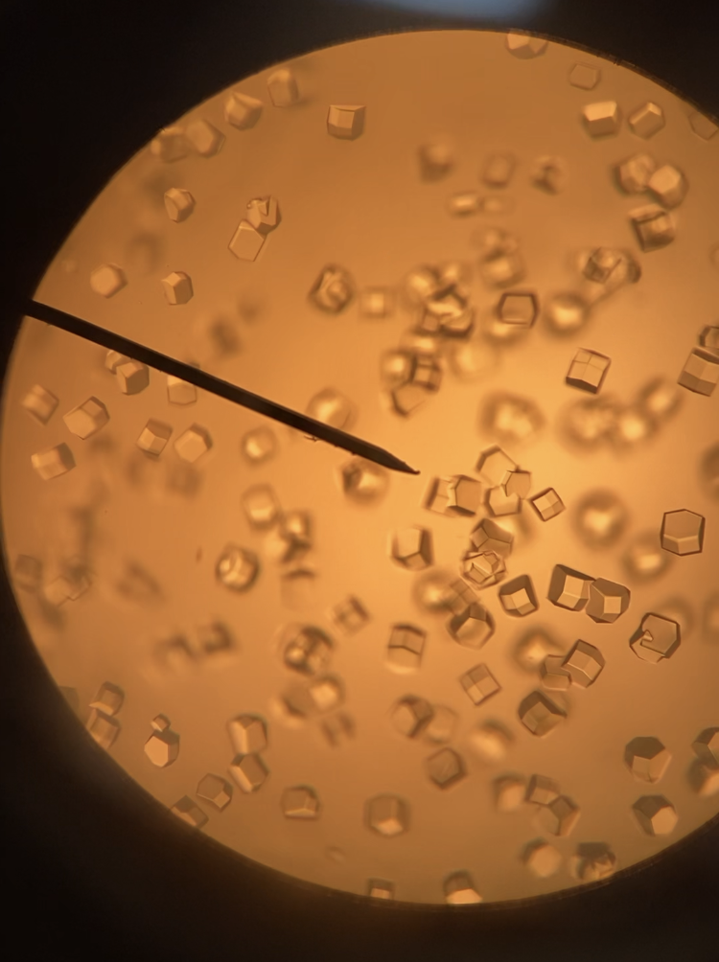
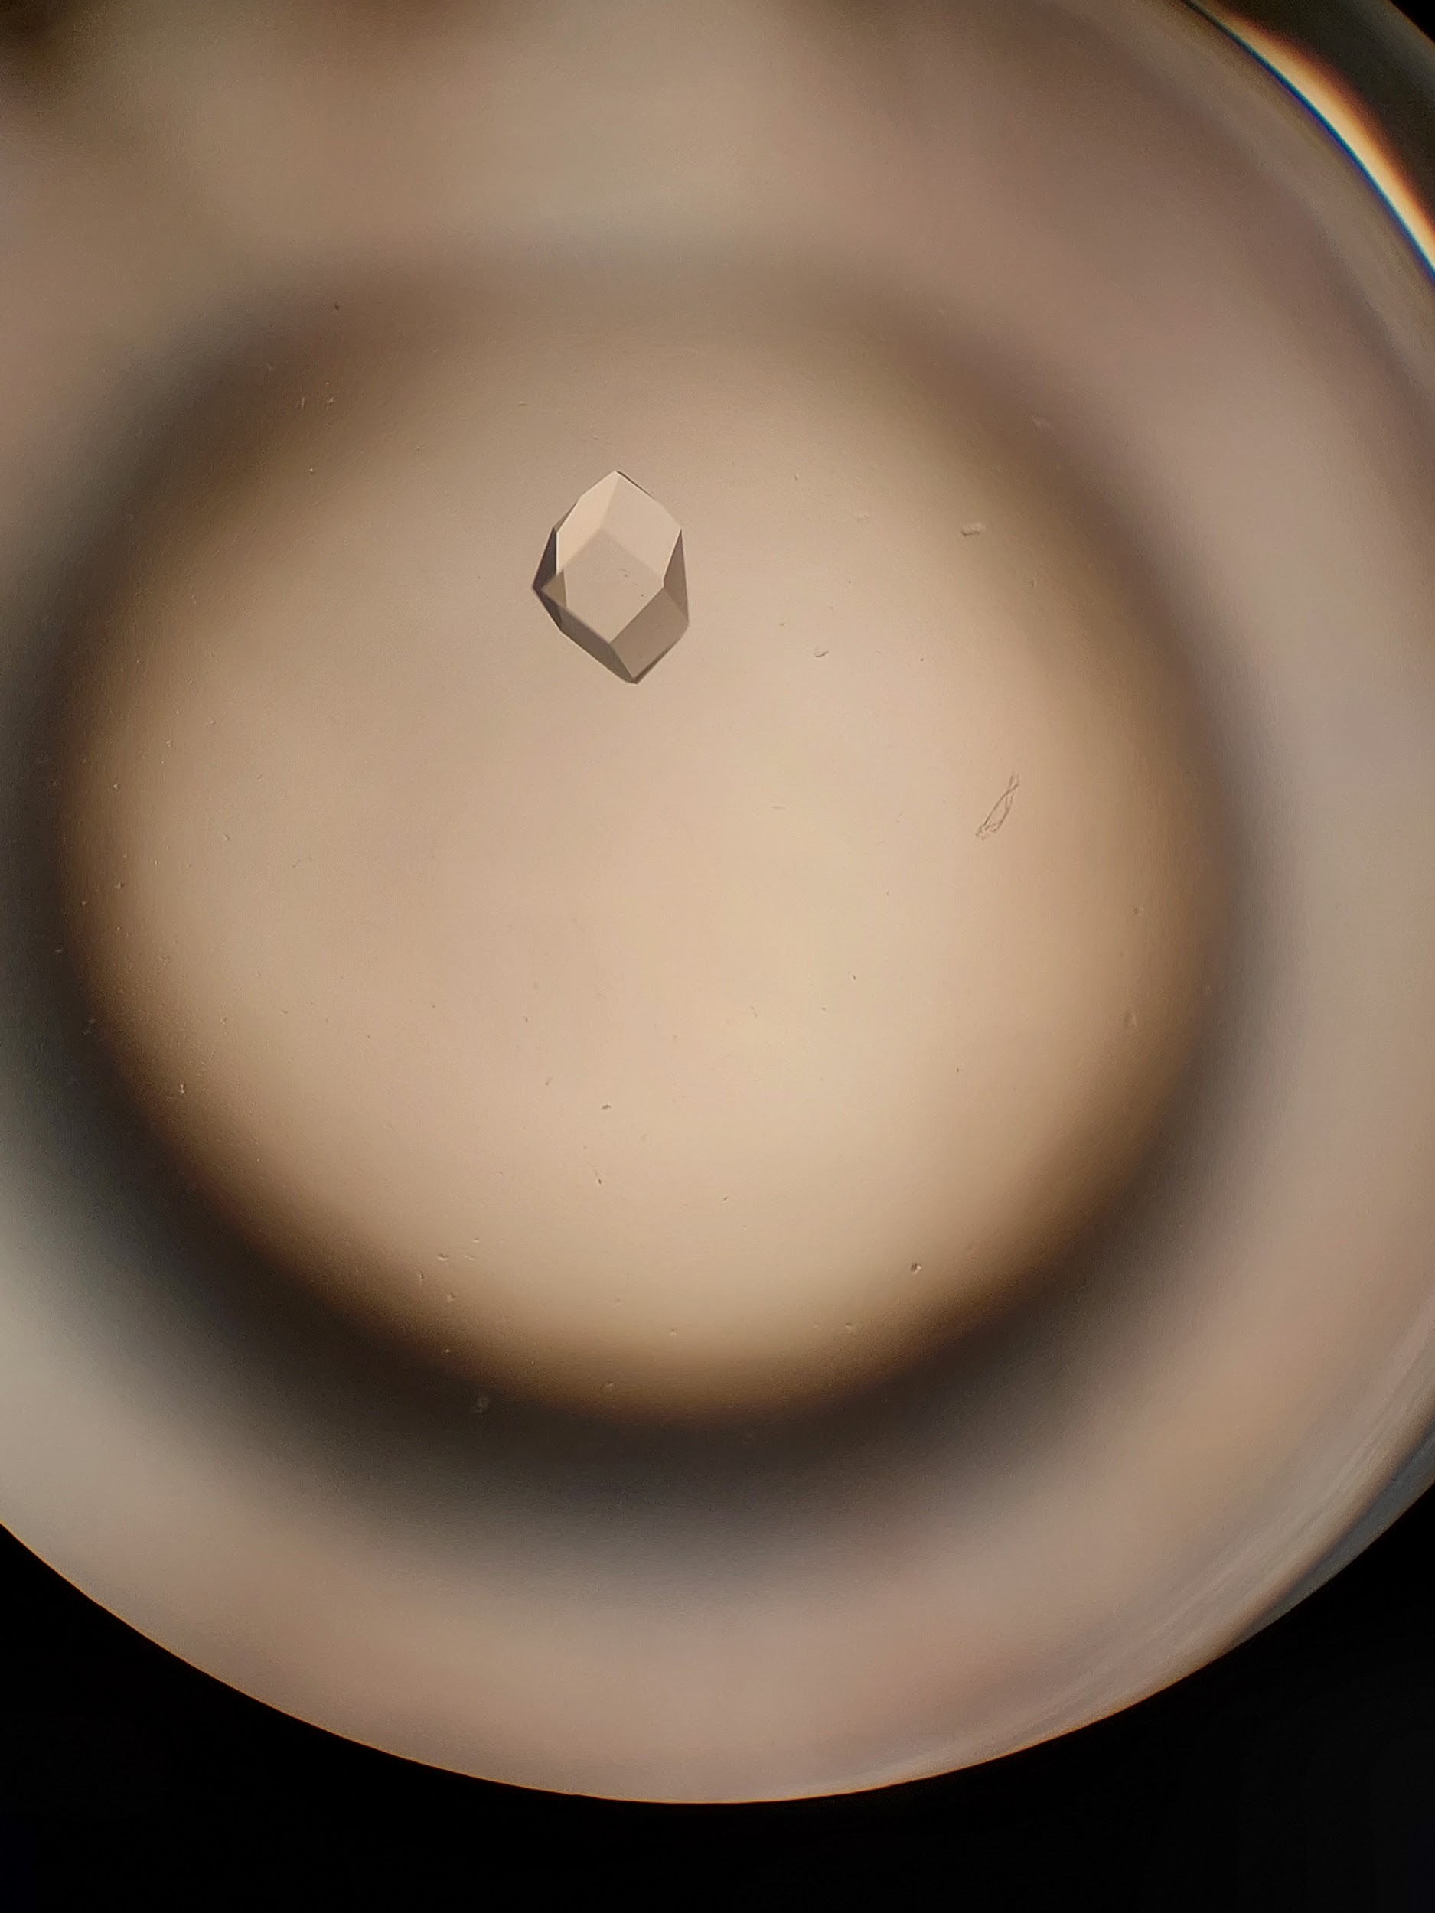
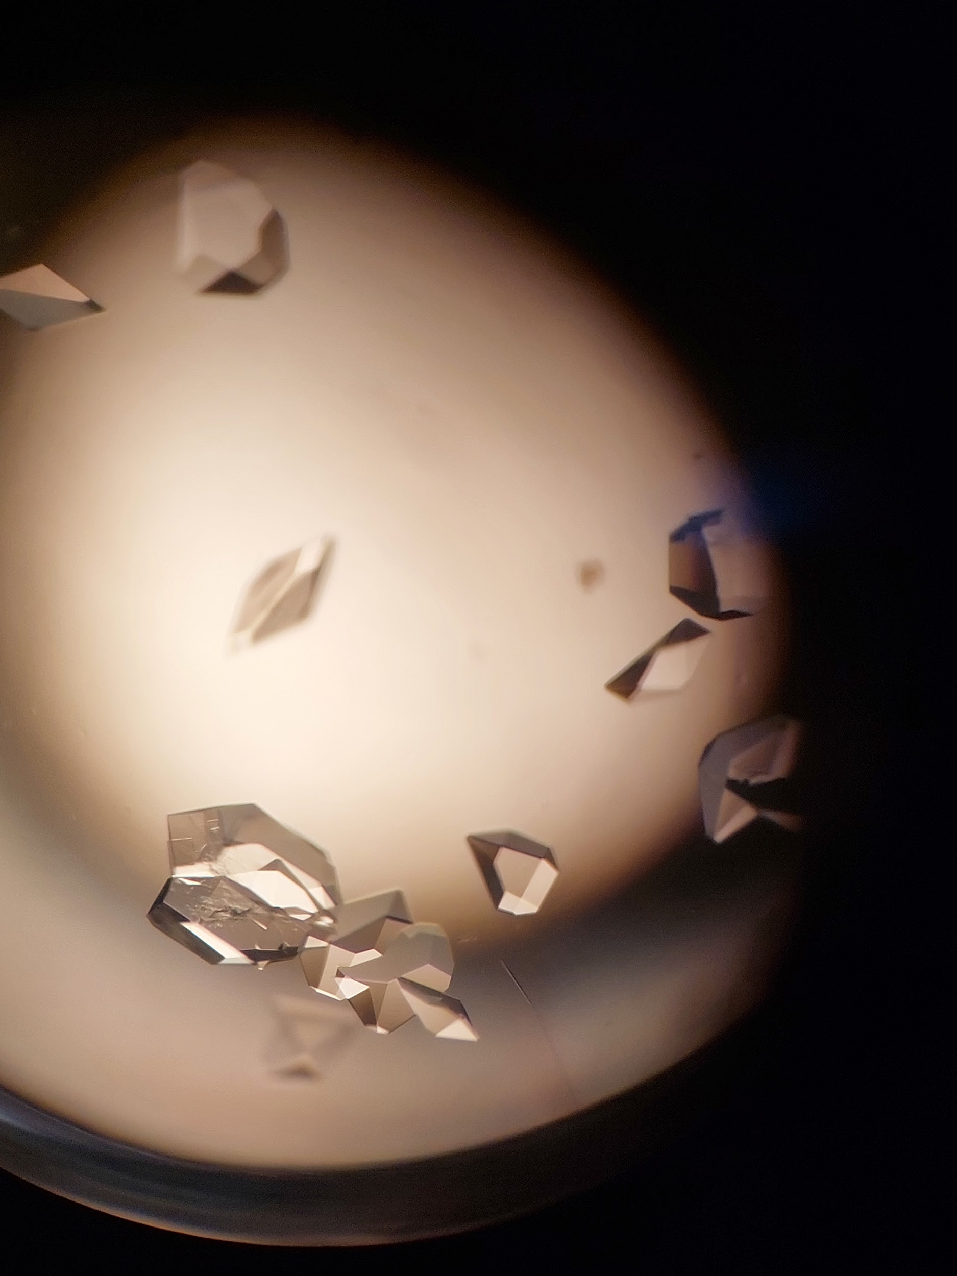
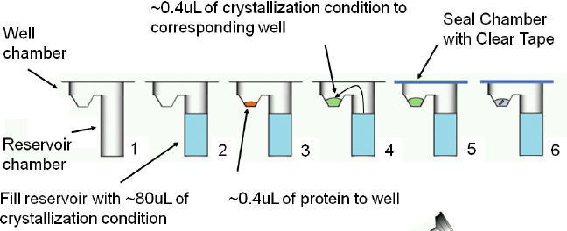
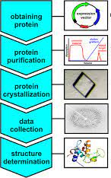
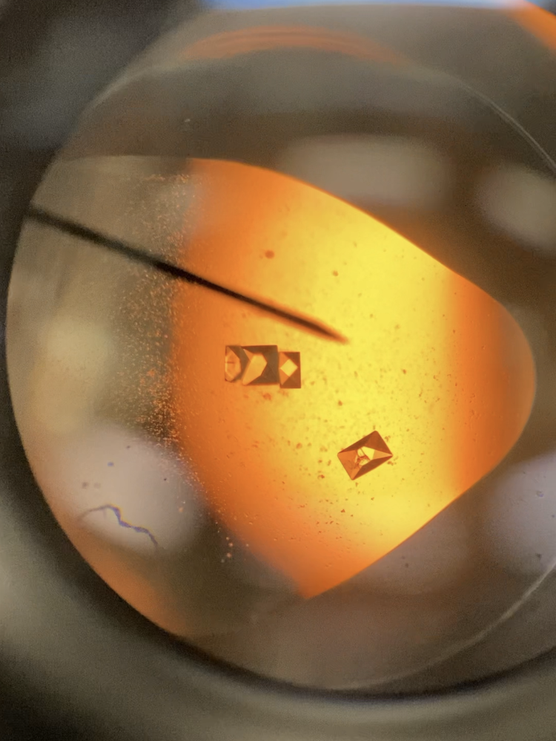
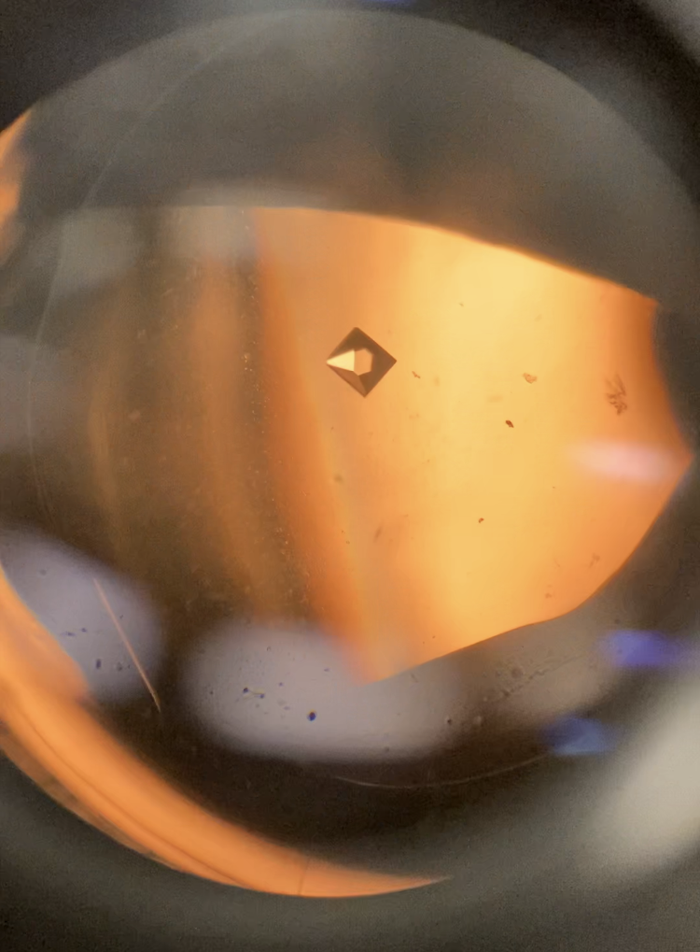
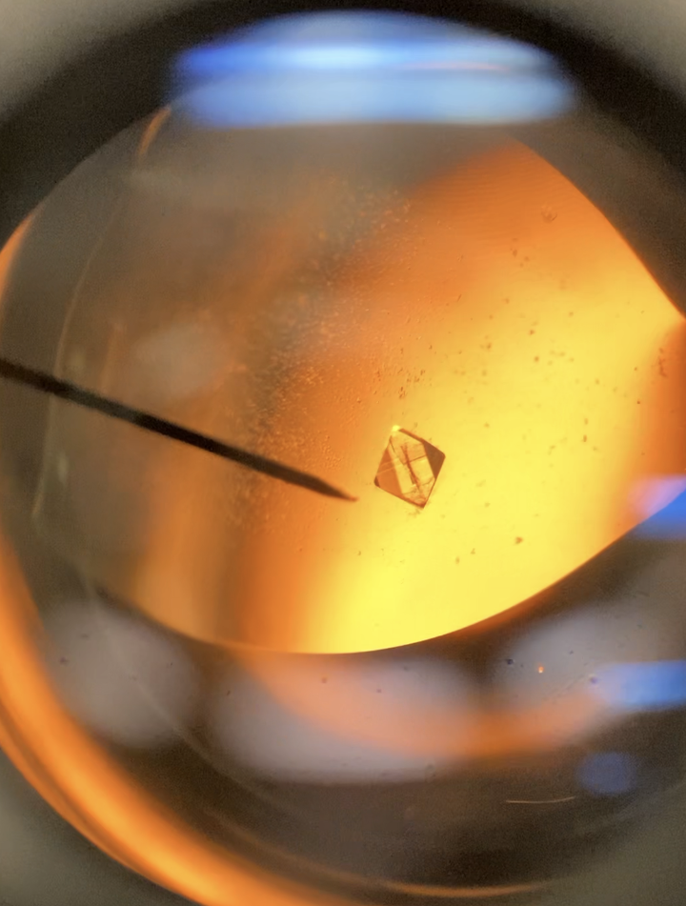
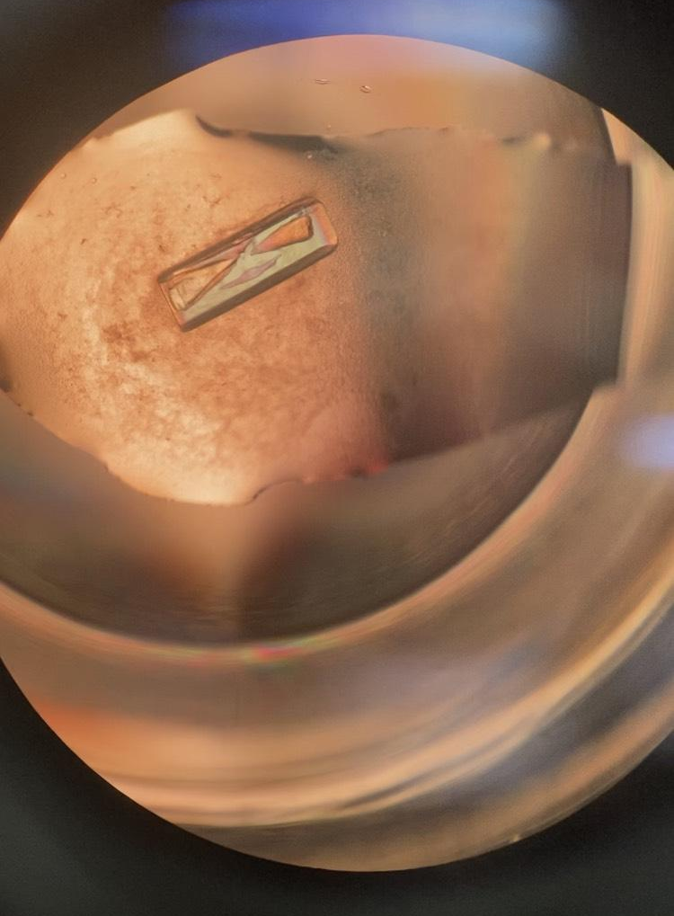
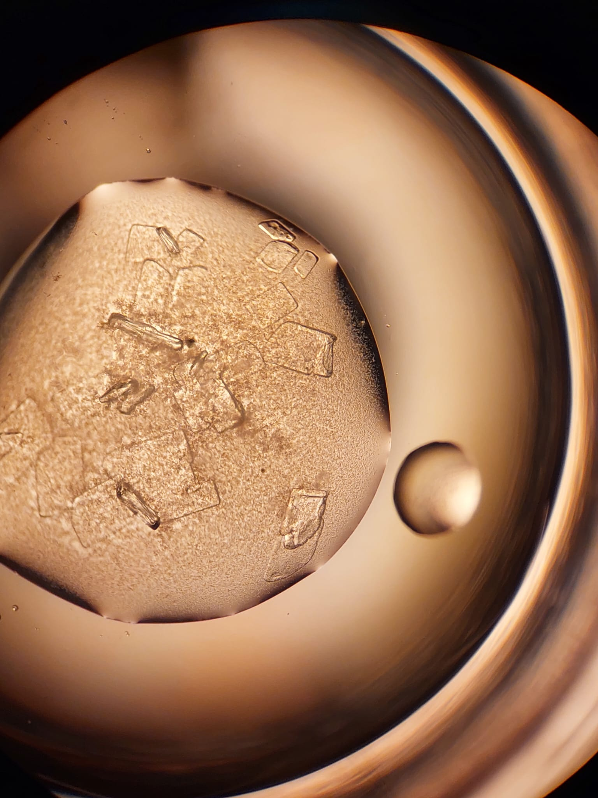
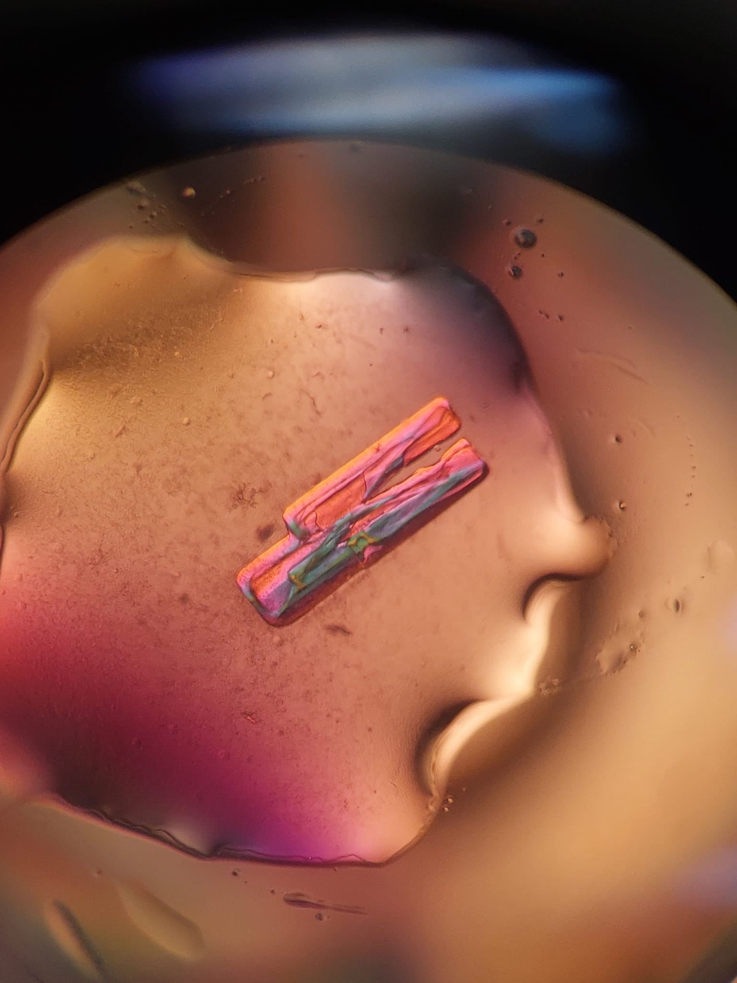
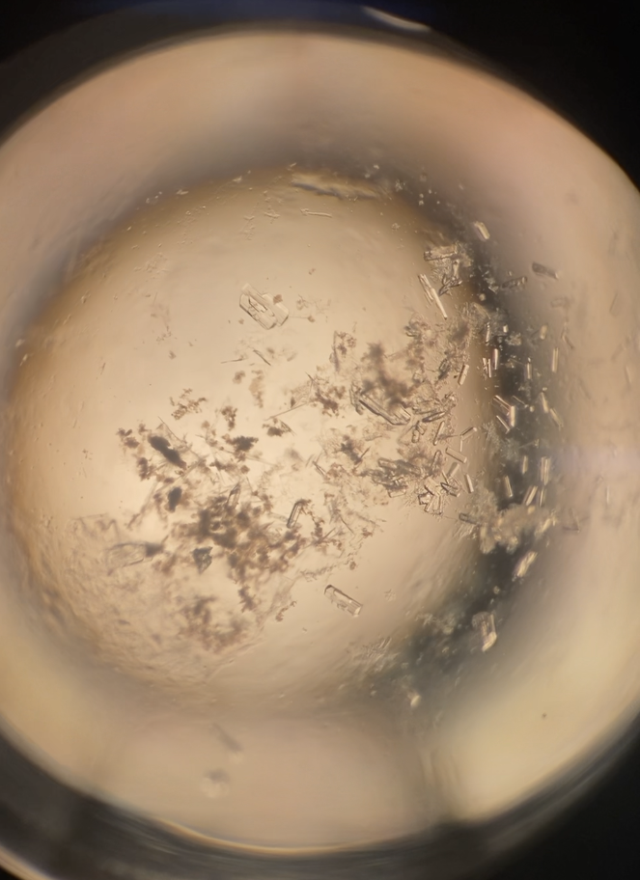
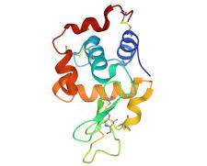
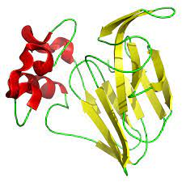
Macromolecular Crystallizations: growing and characterizing crystals, suitable for diffraction analysis, of novel proteins
Authors: Wendy Alvarez (BIOL Second Year Undergraduate) , Jagriti Chander, Andrew Howard
Department of Biology, Lewis College of Science and Letters, Illinois Institute of Technology, Chicago, Illinois, 60616
National Science Foundation (NSF) Award Number 2050916
Summer 2023 IIT Research Experiences for Undergraduates (REU) Participant
Abstract
Method
Results
Macromolecular crystallography is the technique of producing crystal structure of proteins and polynucleotides using X-Ray Diffraction (XRD) to obtain the arrangement of atoms based on the data collected. This data is used to determine the structure and understand the functions and interaction of the macromolecule. For clinically significant proteins, knowledge of their structures can help guide the development of therapeutics.
Sitting Drop Vapor Diffusion
Lysozyme - Hampton Kit-128
We grew crystals in 24-compartment plastic sitting-drop plates.
Each compartment consists of a well containing 200 µL of a precipitant solution and a shelf containing 1 µL of protein solution mixed with 1 µL of precipitant.
We seal the tray with tape and examine the protein shelves every 48 hours for signs of crystallization, which will occur as the protein mixture becomes supersaturated.
Crystal | Condition Solution
1 (B3) | 0.2 M Ammonium acetate, 0.1 M Sodium citrate tribasic dihydrate pH 5.6, 15 % w/v Polyethylene glycol 4,000
2 (C3) | 0.1 M HEPES sodium pH 7.5, 2% v/v Polyethylene glycol 400 1.0 M Ammonium sulfate
3 (C5) | 0.05 M Potassium phosphate monobasic, 10% w/v Polyethylene glycol 8,000
1.)
2.)
3.)
Plant Thaumatin - Hampton Kit-128
Crystal | Condition Solution
1 (4) | 0.1 M TRIS hydrochloride pH 8.5, 2.0 M Ammonium sulfate
2 (34) | 0.1 M HEPES sodium pH 7.5, 0.1 M HEPES sodium pH 7.5, 0.8 M Potassium phosphate monobasic
3 (me) | 0.1 M HEPES sodium pH 7.5, 0.1 M HEPES sodium pH 7.5, 0.8 M Potassium phosphate monobasic
Figure 2 - The figure shows how the crystallization trays are setup and how the Sitting Drop Vapor DIffusion phenomena works.
1.)
2.)
3.)
Reservoir Chamber Conditions
Bovine Citrate Synthase - Rigaku Wizard Cryo 1 and 2 block
Figure 1 - This figure shows the Macromolecular Crystallization process
The use of Hampton Kit HR2-128, Hampton Kit HR2-110, Rigaku Block Wizard Classic 1 and 2, and Rigaku Wizard Cryo 1 and 2 block provided 350 pre-made conditions that provided us with the ability to successfully grow protein crystals. Once successful crystals were observed a solution of the crystals environment were made and the pH was varied to determine optimal conditions for crystal growth.
Objective
Crystal | Condition Solution
1 (C9) | 40% (v/v) ethylene glycol; 100 mM MES/ NaOH pH 6.0; 200 mM Zinc acetate
2 (D7) | 40% (v/v) ethylene glycol; 100 mM MES/ NaOH pH 6.0; 200 mM Zinc acetate
3 (G2) | 25% (v/v) 1,2 propanediol; 100mM imidazole/HCl 8.0; 200 mM Zinc acetate; 10% (v/v) Glycerol
Produce well-ordered crystals of hen egg-white Lysozyme, Plant Thaumatin, Bovine Citrate Synthase, and Recombinant Human GNB3.
Obtain XRD data from lysozyme and thaumatin to serve as positive controls.
Obtain XRD data from citrate synthase to obtain a fuller understanding of its mechanism.
Obtain XRD data from GNB3 to develop a de novo model of its structure.
Future Work
1.)
2.)
3.)
Arrange to cryo-cool, ship, and collect XRD data on the samples of the four proteins
Use appropriate software to determine or re-determine the proteins’ structures
Expand the project to include another clinically significant protein, OTUD6B
Recombinant Human GNB3 - Rigaku Block Wizard Classic 1 and 2
Crystal # | Condition Solution
1 (C1) | 30% (v/v) PEG 400, 100 mM Tris base/ Hydrochloric acid pH 8.5, 200 mM Magnesium Chloride
2 (C4) | 20% (v/v) PEG 3000, 100 mM HEPES/Sodium hydroxide pH 7.5, 200 mM Sodium Chloride
3 (F11) | 15% (v/v) Reagent alcohol, 100 mM HEPES/ Sodium hydroxide pH 7.5, 200 mM Magnesium Chloride
1.)
2.)
3.)
References
https://www.researchgate.net/publication/327271939_Polyoxometalates_more_than_a_phasing_tool_in_protein_crystallography
https://smb.slac.stanford.edu/
https://hamptonresearch.com/cat-1.html
https://rigakureagents.com/collections/blocks
https://hamptonresearch.com/uploads/cg_pdf/CG101_Sitting_Drop_Vapor_Diffusion.pdf
Figure 1.2 - Hen egg-white Lysozyme
Figure 1.3 - Plant Thaumatin
Undergraduate
8/20/21

