Slide 1

Fiber Diffraction of Muscle

Slide 2
Why X-ray Diffraction of Muscle?
Force producing events occur on the time scale of ≤ 1 ms
Relevant size scale is 5 - 50 nm for molecular machinery
X-ray diffraction only technique that allows simultaneous collection of structural and physiological information on this time scale
Can be used on living systems to do real physiological experiments
2
Notes:
2

Slide 3

The Advanced Photon Source

Slide 4
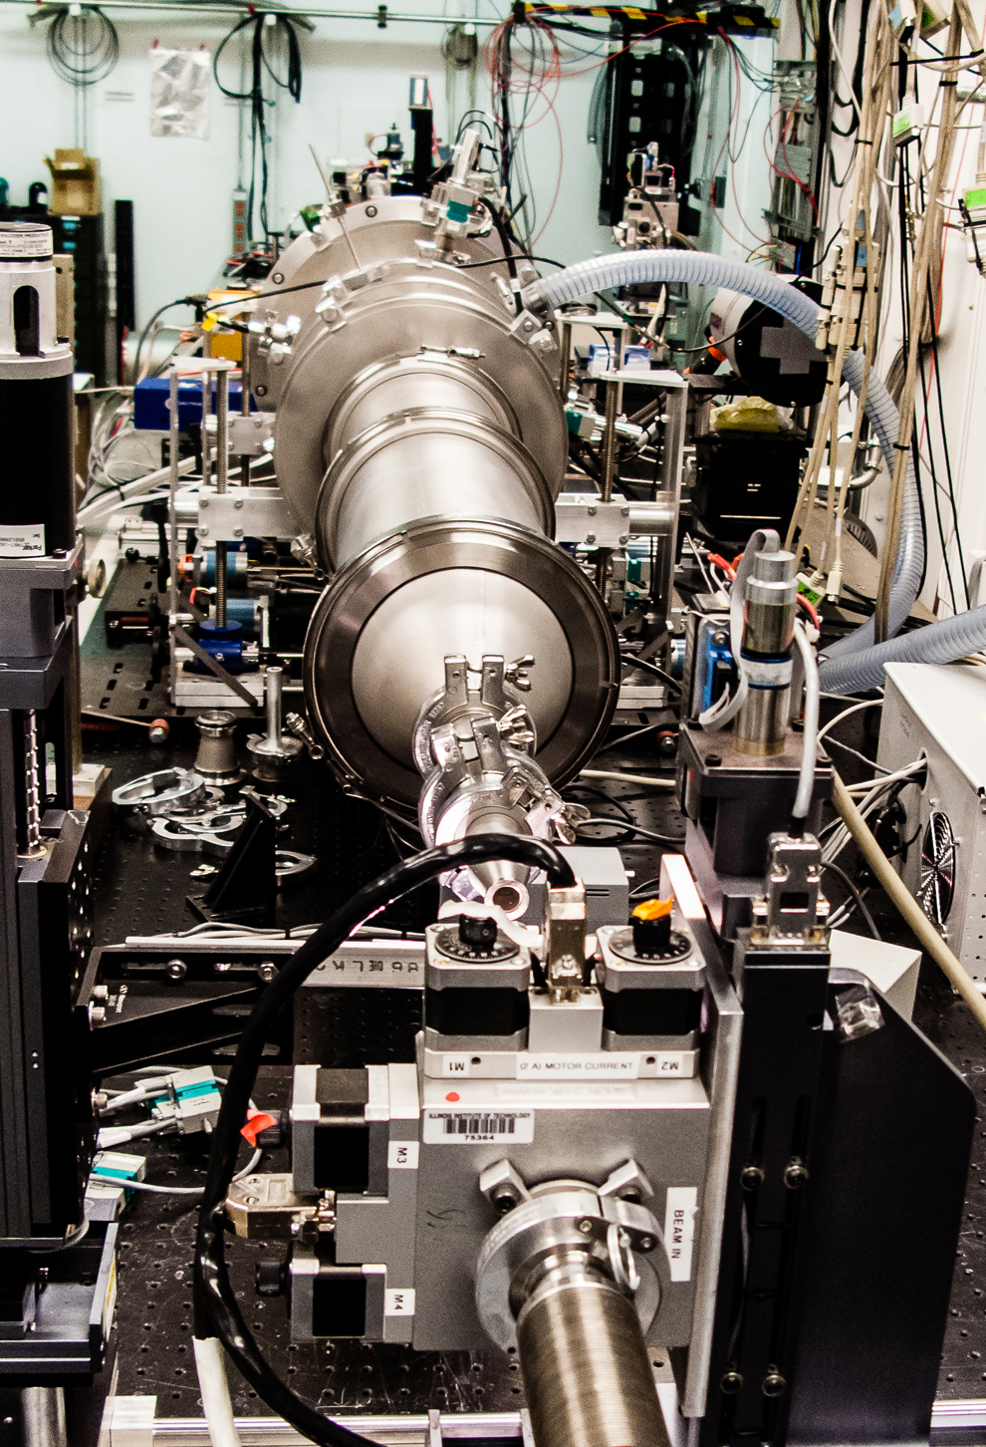
SAXS Instrument on the BioCAT
Beamline 18ID at the APS

Slide 5
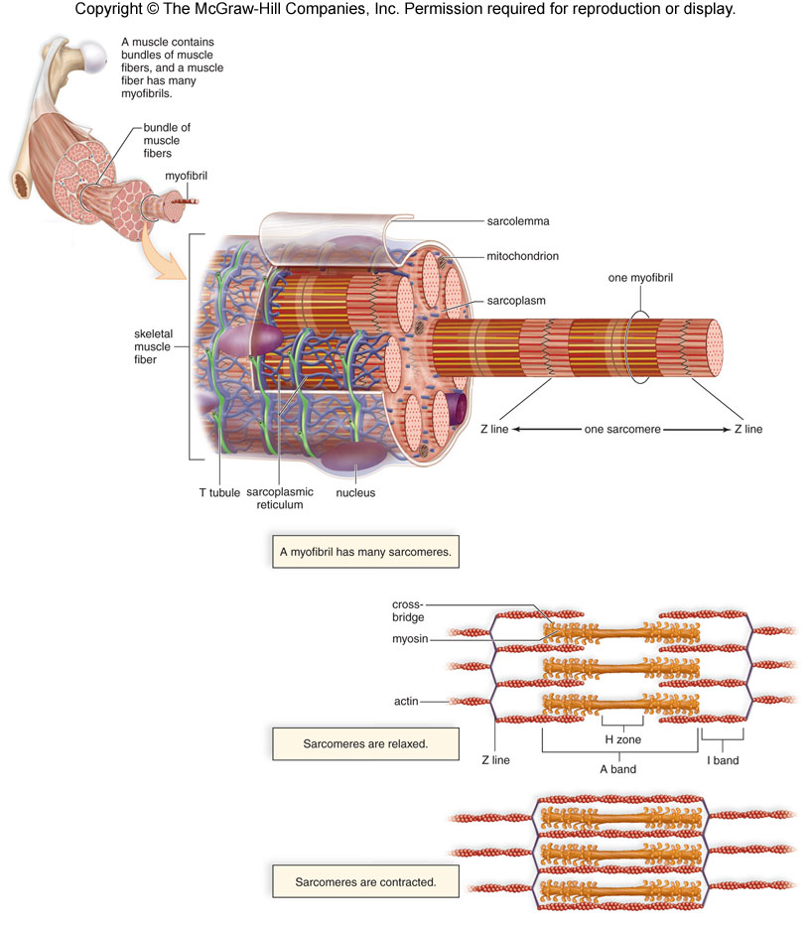
Myofibrils and Sarcomeres
A myofibril consists of many 2-3 micron long sarcomeres laid end to end
In the light microscope, sarcomeres show a banding pattern (striations)
A-band, I band, Z-line, and M-line, H-zone
Underlying structure can be seen only at electron microscope level

Slide 6
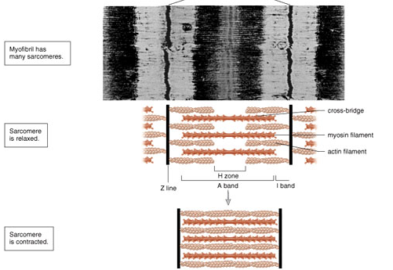
Sarcomeres
Sarcomere consists of actin containing thin filaments
Myosin containing thick filaments
I band contains only thin filaments
H-zone only thick
A-band both thick and thin
11-9

Slide 7
Sarcomeres
Projections on the thick filament (crossbridges) interact with the thin filament and cause sarcomeres to shorten
11-9

Slide 8
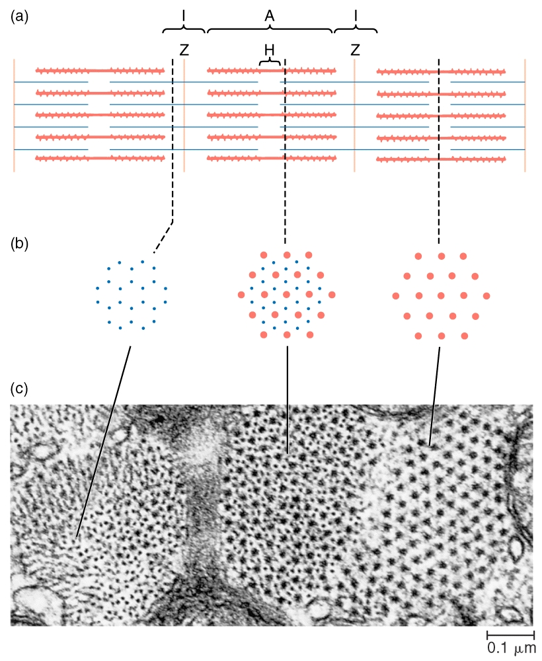

Slide 9
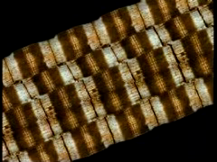

Slide 10
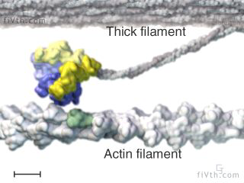

Slide 11
Using X-ray Diffraction to Measure Lattice Spacing
muscle
bath
CCD
detector
mirror
X-rays
evacuated flight tube
synchrotron X-ray source
X-rays
diff.
actin
myosin
1,1
d
A
θ
C
θ
B
θ
1,0
AB=BC=d₁₀ sin θ
D
X-rays
2θ
F
2sin ϑ = nλ/d
2sin ϑ = D/(D²+F²)^{1/2}
d10 = (nλ(D²+F²)^{1/2}/D)/2
inter-thick filament spacing = d10*(2/√3)

Slide 12
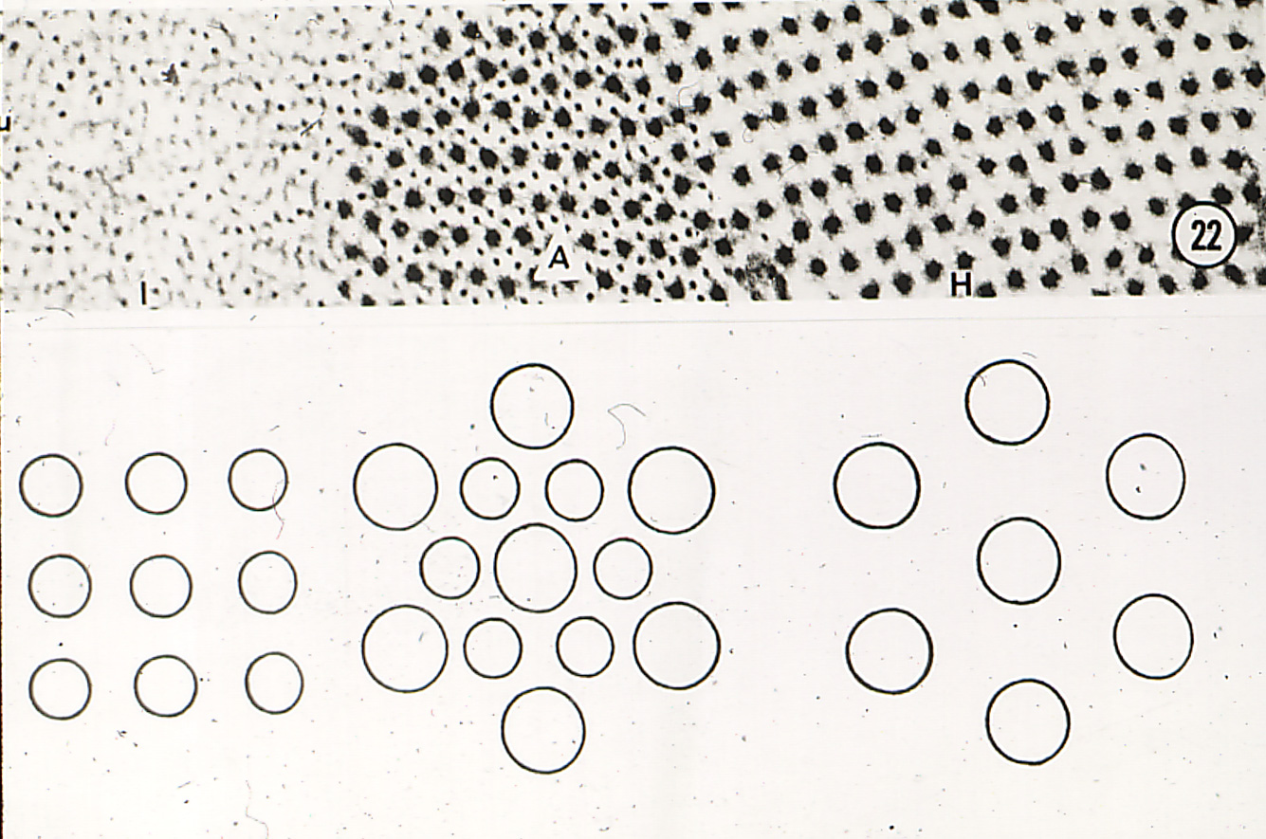
Cross-sections of a sarcomere showing 2-D crystalline structure
Thick and thin filaments overlapping in A-band
Thick filaments Only in H-zone
Thin filaments near Z band

Slide 13
Hexagonal Lattice
u
y
→
b
a
→
x
a
→
→
b

Slide 14
Ewald Sphere
k a*
2 θ
1
O
λ
h a*
For every lattice in real space there is a corresponding lattice in “recripocal” i.e. diffraction space. Distances between lattice points are proportional to 1/lattice dimensions in real space. The origin of the reciprocal lattice is at O. Lattice points (corresponding to diffraction spots one can observe) are indexed by Miller indices h and k

Slide 15

End on view of hexagonal reciprocal lattice
This was taken by shining the X-ray beam down the axis of a muscle myofibril.(one crystallite)
Not the way we normally do it.

Slide 16
Fiber Cross-section
Diffraction
X-rays
Myofibrils are at random orientations around the long axis of the muscle fiber
Complete Statistical rotation:
1,0 = 1,0 = 0,1 = 0,-1
1,1 = 1,1=1,1 = 1,-1

Slide 17

Equatorial pattern from insect muscle
We are looking at projection of hexagonal lattice onto a plane. Insect muscle is highly ordered so you get lots of sharp spots along the equator.
Note that they vary in intensity
Equator

Slide 18
Experimental arrangement of the BioCAT undulator beam line for X-ray diffraction
muscle
bath
CCD
detector
mirror
X-rays
evacuated flight tube
(X-ray reflections)
undulator X-ray source
(electrons)
inverted
microscope
X-rays
diff.
actin
myosin
1,1
d
A
θ
C
θ
B
θ
1,0
AB=BC=d₁₀ sin θ
D
X-rays
2θ
F
2sin ϑ = nλ/d
2sin ϑ = D/(D²+F²)^{1/2}
d = (nλ(D²+F²)^{1/2}/D)/2
inter-thick filament spacing = d*(2/√3)

Slide 19
Calculating d₁₀
Braggs Law
nλ = 2dsinθ
θ is the Bragg angle where 2 is the angle between the diffracted and incident beam
At small angles
Θ = D/2L so that
nλ = 2dD/2L
Or
d=nλL/D
So d, the spacing between the diffracting planes is inversely proportional to D, the distance from the origin of the diffraction pattern to a diffraction spot

Slide 20
Hexagonal pattern selection rule
The distances from the center of the pattern to each of the outer reflections (S_{h,k}) are related to the distance from the center to the first strong 1,0 reflection, S₁₀, by S_{h,k} = S₁₀√(h² + k² + hk) where h and k are the Miller indices of each reflection. Notice that several combinations of h and k values will give rise to the same S_{h,k} meaning that X-ray reflections will superimpose.

Slide 21
Estimating lattice disorder parameters from peak widths
The width of the Gaussian representing a given diffraction peak σ_{h,k} can be expressed as
σ_{h,k} = √(σ_{c}²+ σ_{d}²S_{hk} + σ_{s}²S_{hk}²) where S_{hk} = √(h² + k² + hk). σ_{c} is the known width of the X-ray beam, σ_{d} is related to the amount of heterogeneity in inter-filament spacing among the myofibrils, and σ_{s} is related to the amount of paracrystalline (liquid-like) disorder of the myofilaments in the hexagonal lattice.
These are all interesting physiological paramaters

Slide 22
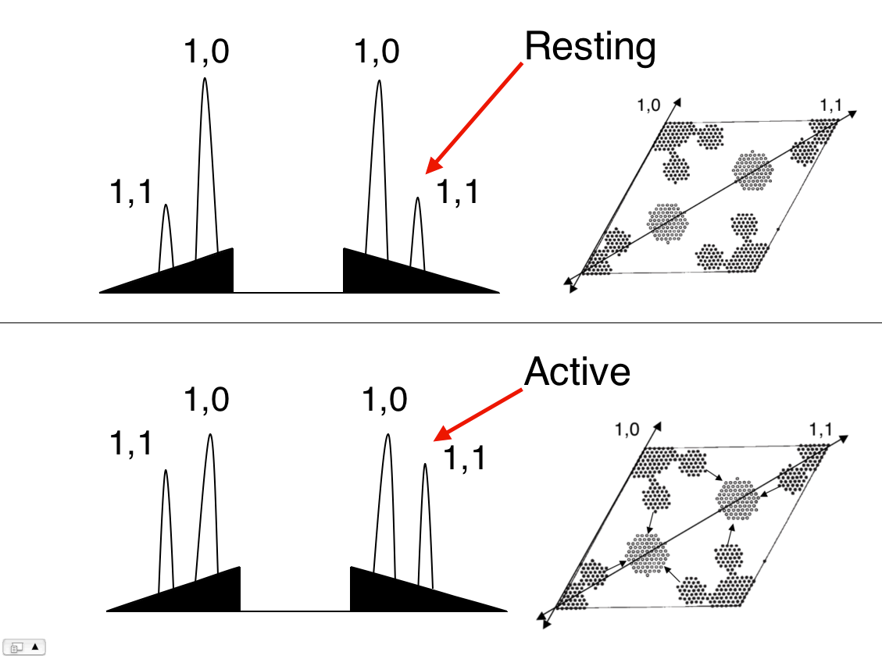
Intensity of Equatorial Reflections as a Measure of Crossbridge Position
When crossbridges reach out and bind to actin there is an increase in the equatorial intensity ratio I₁₁/I₁₀
Notes:
Changes in equatorial peak intensities upon activation . If we plot the intensity profiles of these reflections, we see just that in comparing resting to active muscle patterns. So on the right we see electron density patterns of resting muscle, with mass indicated by black spots and the unit cell defined by dotted lines. The big spots are myosin and the small spots are actin. In active muscle, the outline of the myosin spot becomes less well-defined and the actin spots increase in size dramatically. The intensity profiles of these patterns on the left clearly display the changes in the reflections, as the 1,0 intensity decreases and the 1,1 intensity increases.

Slide 23
I_{1,1}/I_{1,0} in mouse skeletal muscle
A linear relationship in equatorial intensity change to applied tension
Consistent with studies on cardiac muscle: intensity ratio correlates well with tension especially during the early phase of contraction
(Matsubara Annu. Rev. Biophys. Bioeng., 9 (1980)
Notes:
BB at various time to produce a wide range of force to get this whole intensity ratio change and tension curve. Looks linear
BB alter myosin behaviors which probably comprise the linear relationship.
What we plotted was the difference of intensity ratios between resting and plateau regions, what about the force arising phase. So we did a time-resolved experiment to look at this.
the intensity changes follows tension very well even though It wasn’t strictly linear.
And if only plot the curve upto 60% percent of maximum force, the relationship between I_{1,1}/I_{1,0} and submaximum tension was linear.
Tension is proportional to the number of attached cross-bridges
Whether it is strictly linear or not, this makes the intensity ratio data more informative.

Slide 24


Skeletal Muscle X-ray Diffraction at BioCAT
Weikang Ma, T. Irving
Illinois Institute of Technology, Chicago IL

Slide 25
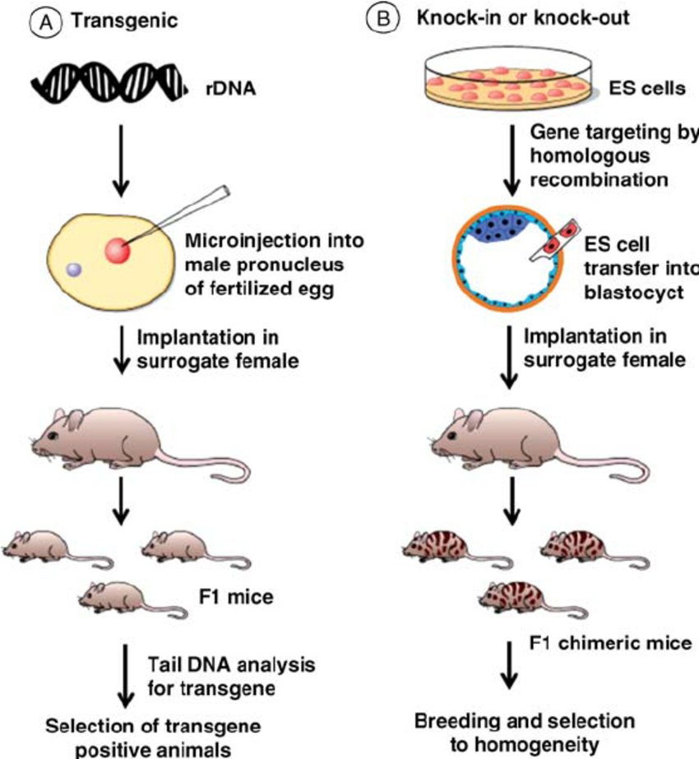
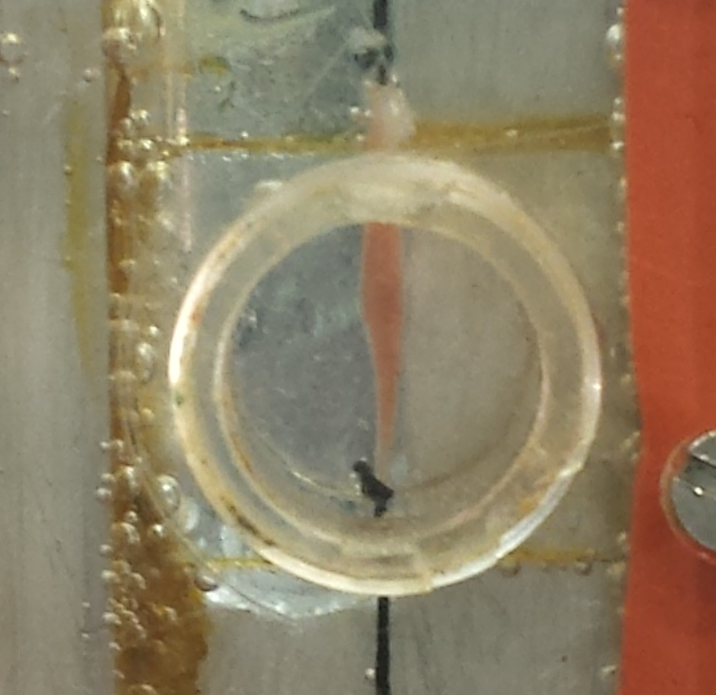
Mouse skeletal muscle XRD in BioCAT
Soleus
EDL
DOI 10.1002/14356007.a12_319
Notes:
Early X-ray: insect IFM, and frog and rabbit psoas muscle
Why mouse skeletal muscle?
For every disease associate to any mutation in sarcomeric proeteins, a animal model can be generated. And mouse model was the most widely used.
Mouse soleus and EDL at 1cm long and 1mm wide which at the sweet spot for X-ray diffraction.

Slide 26
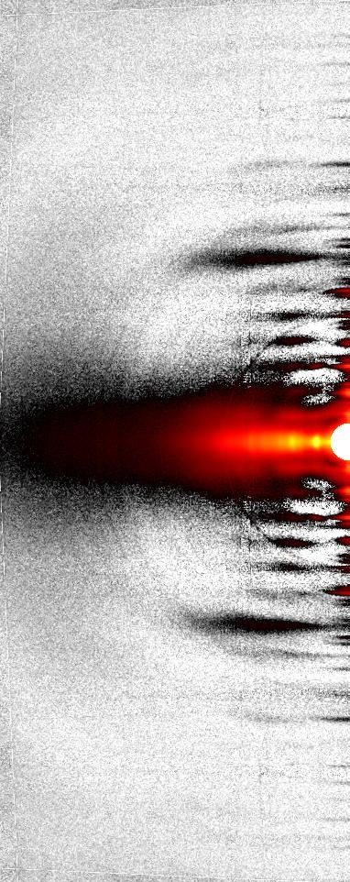
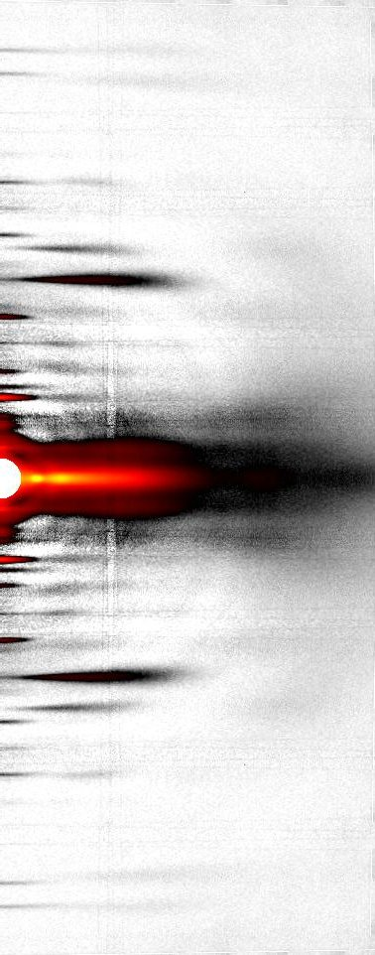
Muscle X-ray pattern
Meridian
Layer lines
Equator
Relaxing
Contracting
Notes:
Everything that is not on the meridian or the equator is called a layer line.

Slide 27
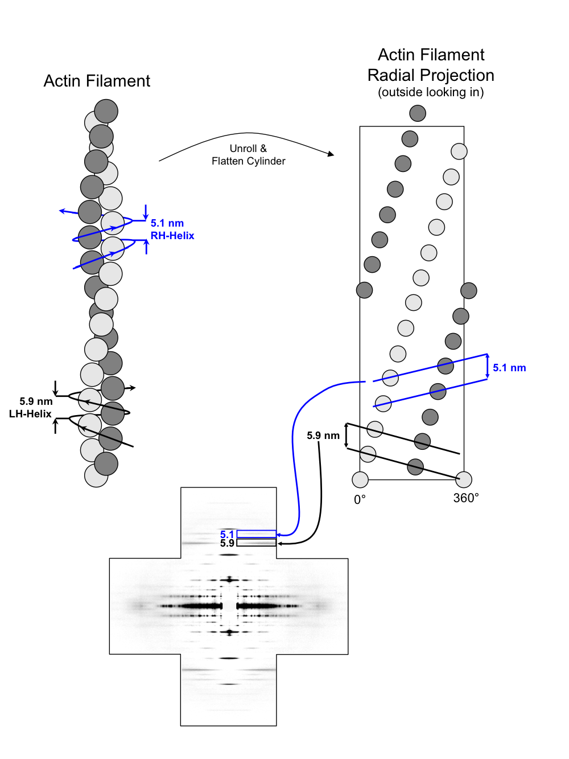

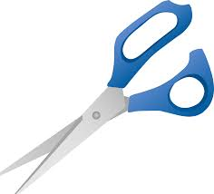
Thin filament based reflections
Actin 2.73nm
5.1nm
5.9nm
2.73nm
5.9nm
5.1nm
Relaxing
Contracting
Notes:
To really understand the diffraction patterns, you have to understand a radial projection.
Imagine a barber pole made of paper.
Take a pair of scissors and cut the paper tube vertically and flatten out the paper.
5.1nm pitch 5.9nm pitch 2.7nm axial displacement. And corresponding reflections

Slide 28
Examples
LH_Helix
Nebulin mutations leads to nemaline myopathy
Nebulin cKO mouse model (less nebulin expressed) –was used in this study
Shorter 5.9nm spacing was seen in human biopsy samples from NM Patient
Control
Patient
Notes:
Shorter 5.9 nm left handed helix pitch.
Animal model replicate the phenotypes of the corresponding human disease.

Slide 29

Thin filament extensibility
WT
cKO
Actin 2.73nm
Hypothesis:
Nebulin stiffens the thin filament
2.73nm
Nebulin
Relaxing
Contracting
Modified from Perz-Edwards, Unpublished
Notes:
The thin filament extensibility can be measured the by plotting the axial displacement changes against the applied tension

Slide 30
Thin filament Extensibility
WT
cKO
Thin filament
10.0 pN/(nm·μm),
30.3 pN/(nm·μm)
2.73nm
The 2.73nm relative spacing change as a function of isometric contraction
Balazs Kiss, Eun-Jeong Lee, Weikang Ma, Frank W Li Paola Tonino, Srboljub M Mijailovich, Thomas C. Irving, Henk L. Granzier. Nebulin stiffens the thin filament and augments cross-bridge interaction in skeletal muscle (Proc Natl Acad Sci U S A. 115(41):10369-10374.
Notes:
When we plot the thin filament extensibility from thin filament with and without nebulin, and the slope of the curve showed that the thin filament was three times stiffer with the presence of nebulin. In the meantime, the thick filament extensibility was measured as internal reference showed no difference between cKO and control.

Slide 31
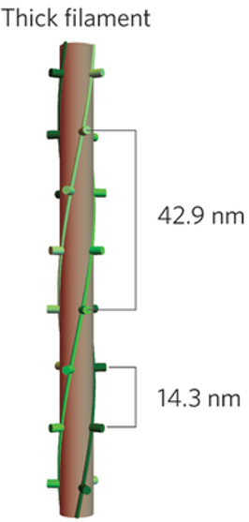
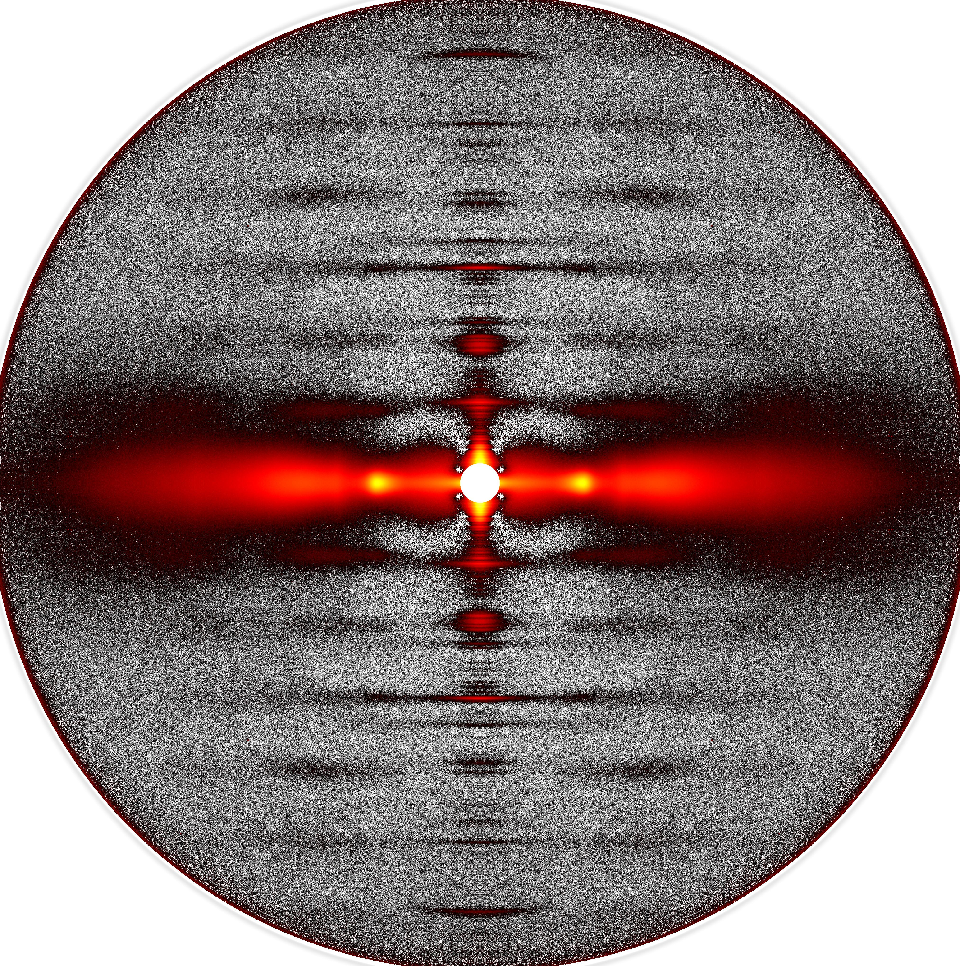
Myosin filament based reflections
MLL1: Helically ordered myosin heads
MLL1 42.9nm
M3: Intensity primarily from myosin heads
M6: Intensity primarily from myosin backbone
M3 14.3nm
M6 7.2nm
E. P. Debold. Biological machines: Molecular motor teamwork
Notes:
The thick filament is a three strands quasi helix with an axial repeat at 42.9nm which will give the first myosin layer line and axial displacement at 14.3nm which will give the third order meridional reflection.
The intensities of M3 are primarily from the myosin heads, and the intensity of the higher orders namely M6 M9 and so on are primarily from the thick filament backbone.
The meridian reflections tell you about axial periodicities

Slide 32
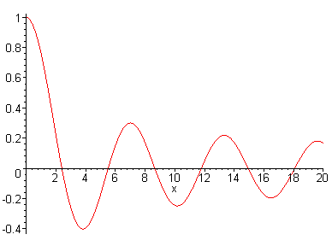
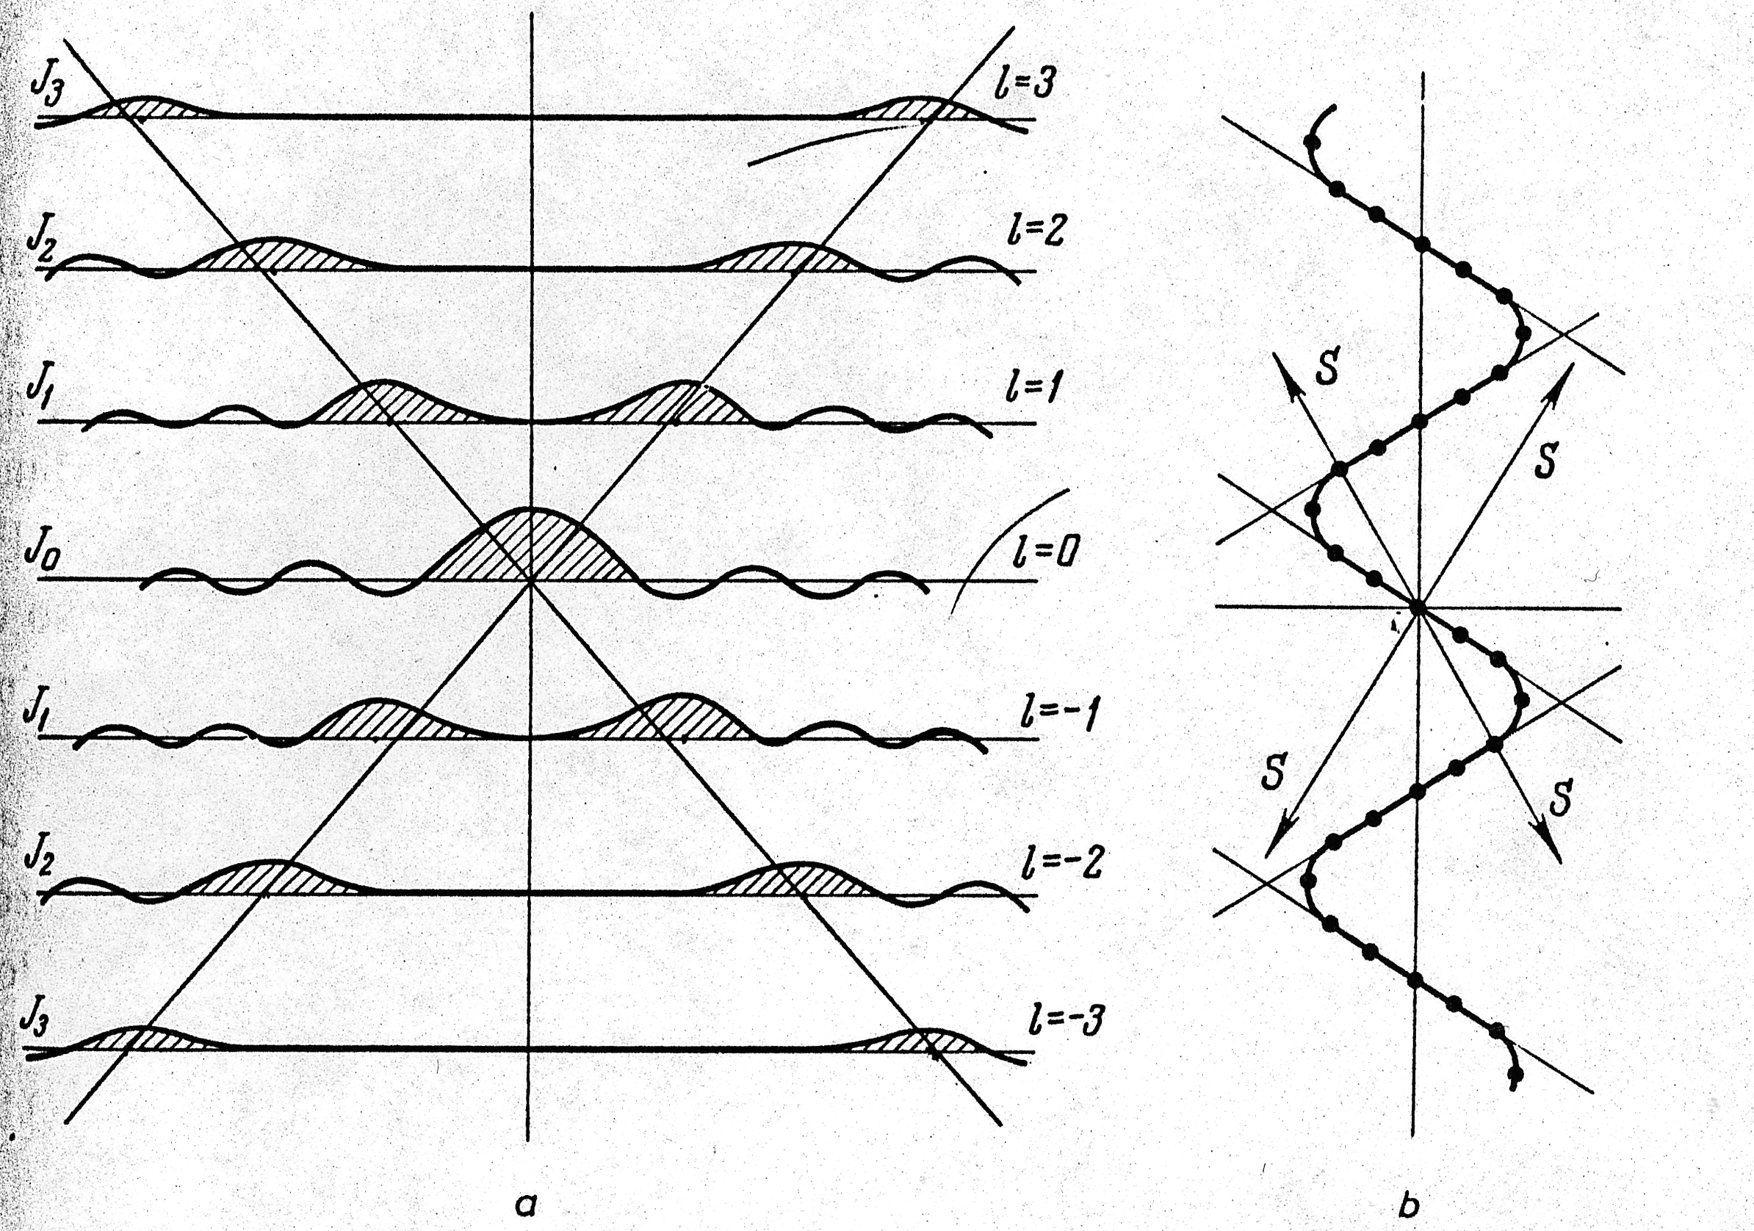
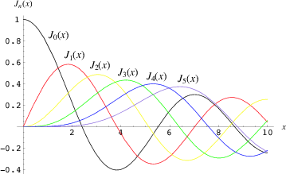
Bessel Functions and Layer lines
Transform of a cylinder

Slide 33
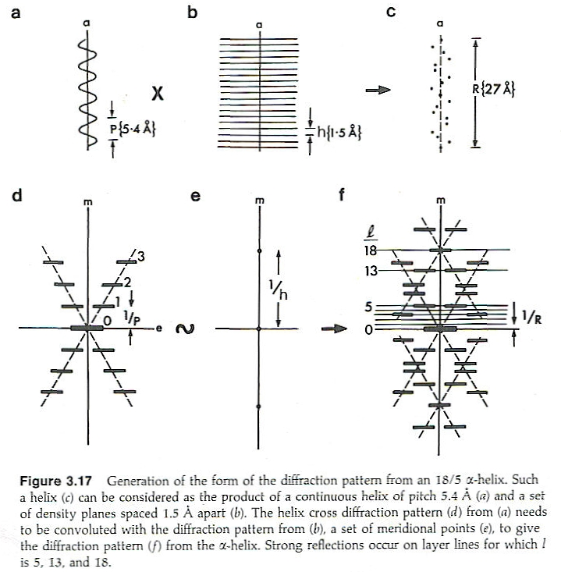
Diffraction From a Discontinuous Helix
A set of points that are regularly spaced along a helical path
l=#residues*m+#turns*n
“Helical Selection Rule”
m indexes meridional reflections
n is the allowed orders of Bessel functions

Slide 34
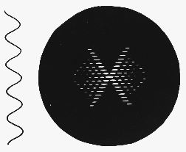
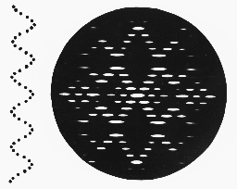
Diffraction from a helix: comparison
The main effect of shifting from a continuous to a discontinuous helix is to introduce new helix crosses with their origins displaced up and down the meridian by a distance 1/h

Slide 35
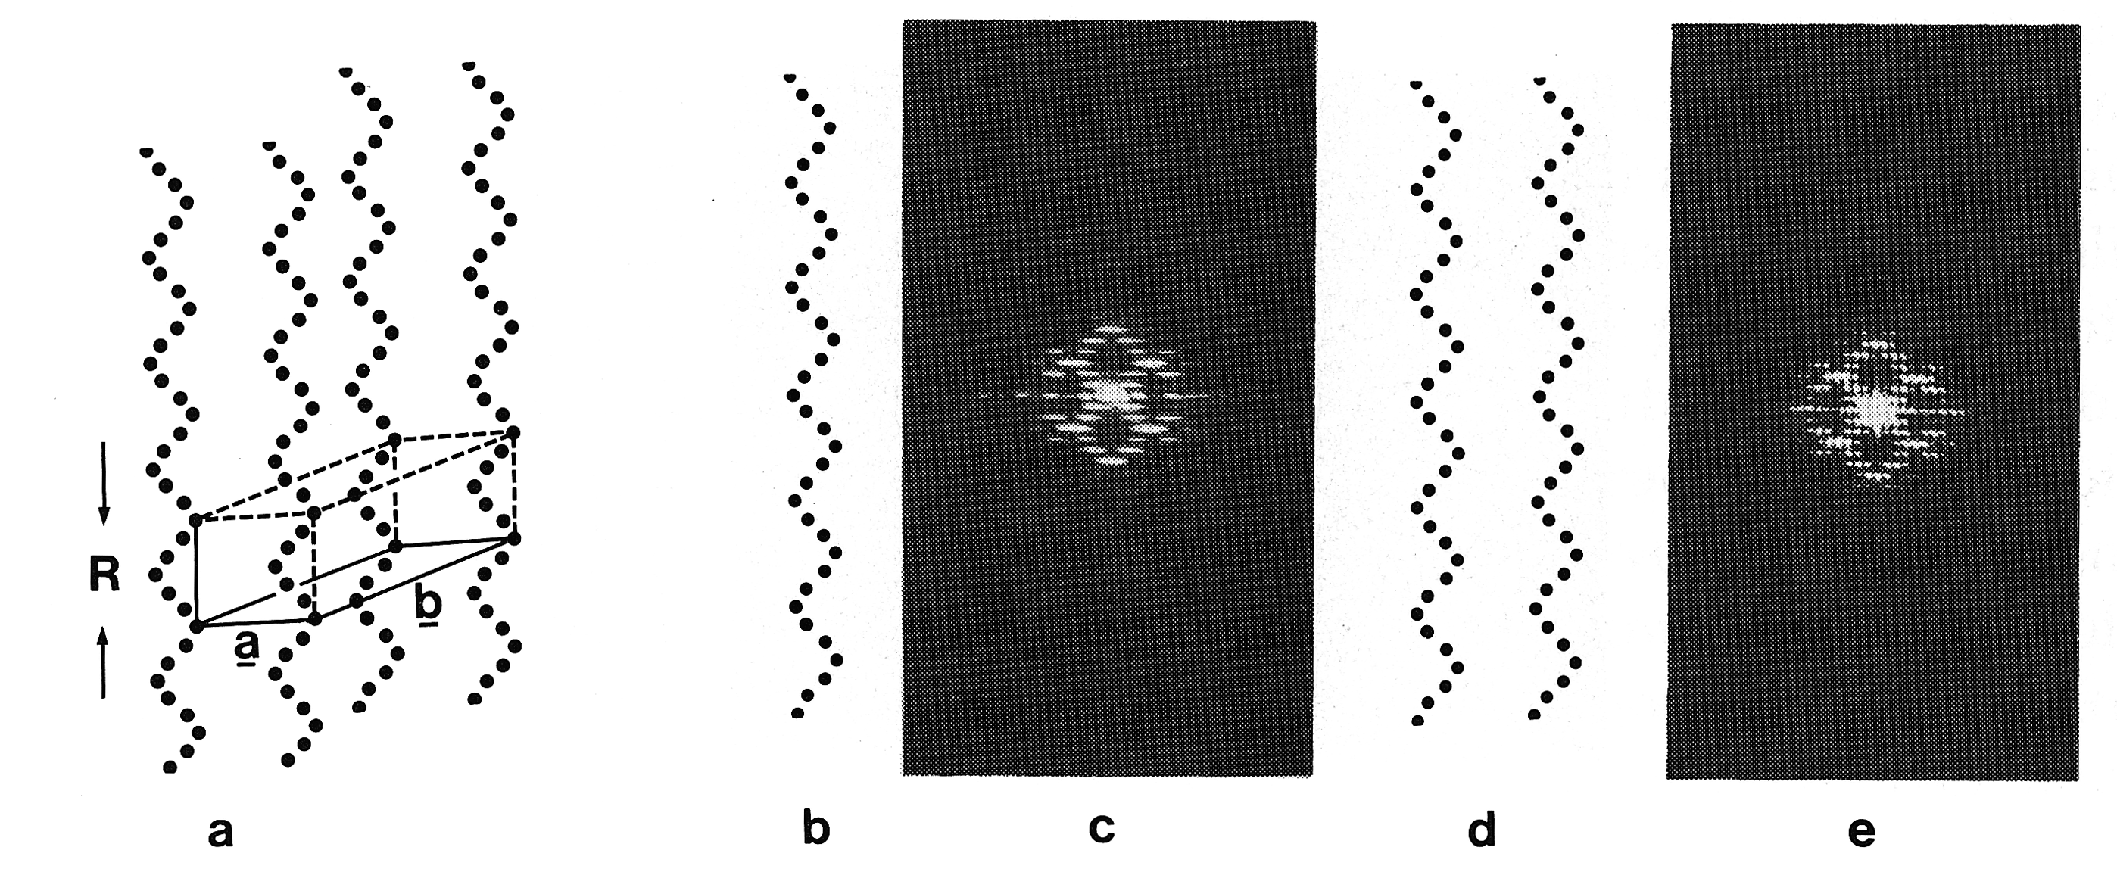
Crystals of Helical Molecules

Slide 36
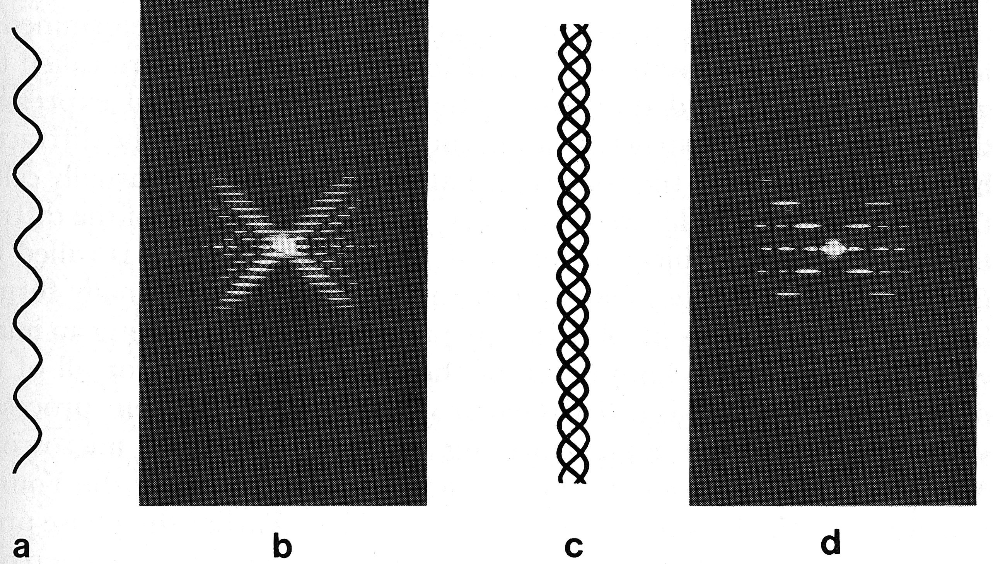
Multi-Stranded (coiled coil) Helices
If N strands Only every Nth Layer -line allowed
Myosin Filaments are 3 stranded

Slide 37
Myosin filament based reflections
M6
The layer line intensity distribution is on the basis of Bessel function
MLL4
The distance between the first maximum layer is reversely related to the average myosin heads radius (R_{m})
MLL1
R_{m}
Notes:
The characteristic X-ray diffraction pattern for helix structure is this X shape, and this was the X-ray diffraction pattern from DNA
The distance between the first maximum layer line reflection can be used to estimate the distribution of myosin heads along the thick filament
When muscle contracts, the helical structural was lost, and the myosin based layer line was replaced by actin based layer lines. So that the myosin layer line was proposed to be the indicator of myosin ON and OFF.

Slide 38
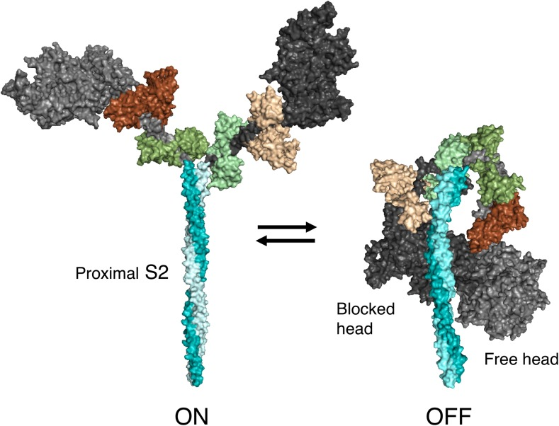
SRX by Muscle X-ray Diffraction
There are two states of relaxed myosin heads: SRX and DRX
If SRX is the only ordered state: MLL only from SRX heads
SRX was characterized structurally the heads are folded back on to its own coiled-coil S2 tail
No changes in MLL spacing when more heads shift to SRX
R_{m}
R_{m}
Trivedi, et al 2018 Biophys Rev
Is DRX really disordered? Or there is another ordered RX
Smaller R_{m} when shifts more myosin heads to SRX
Notes:
SRX state has been an interesting topic, and I think we found some ways to study it structurally.
It has been proposed that there are two states of relaxed myosin heads.
Structurally, the SRX was characterized as
Ordered thing diffracts, disordered thing scatters

Slide 39
R_{m} became smaller with the presence of BB.
I_{MLL} increased with the presence of BB.
At least two ordered relaxed myosin states in skeletal muscle
Increased MLL intensity and/or smaller average myosin heads radius could be indicators of SRX in X-ray diffraction under stable temperature.
Weikang Ma, Henry Gong and Thomas Irving. Myosin Head Configurations in Resting and Contracting Murine Skeletal Muscle. Int. J. Mol. Sci. 2018, 19(9), 2643; doi: 10.3390/ijms19092643
Notes:
Blebbistatin, a small molecular myosin inhibitor, known to shifts myosin into SRX state
BTS, another small molecular myosin inhibitor was used for comparison purpose.
At least two ordered relaxed myosin state, at least in

Slide 40



Structural Basis of the Frank-Starling “Law of the Heart”
Tom Irving¹, Karen Hsu¹,Younss Ait Mou², Edward Allen², Kelly Schoenfelt² and Pieter P. de Tombe²
1 BioCAT, CSRRI, and Division of Biology, Illinois Institute of Technology
2 Dept. Physiology, Loyola University School of Medicine

Slide 41
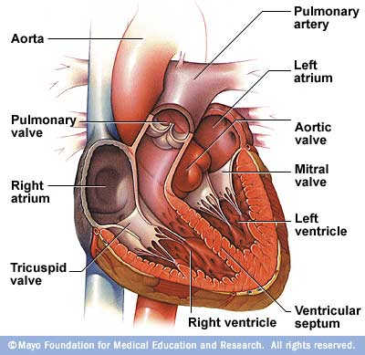
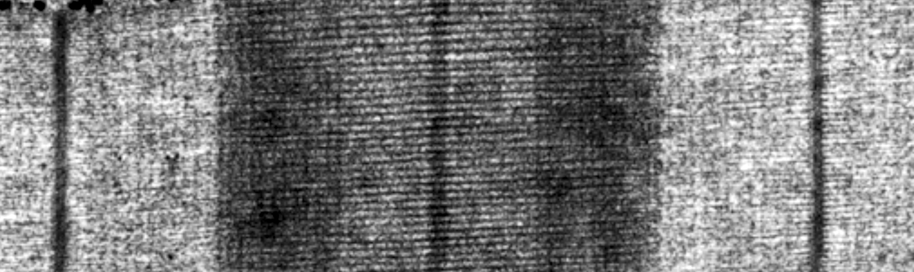
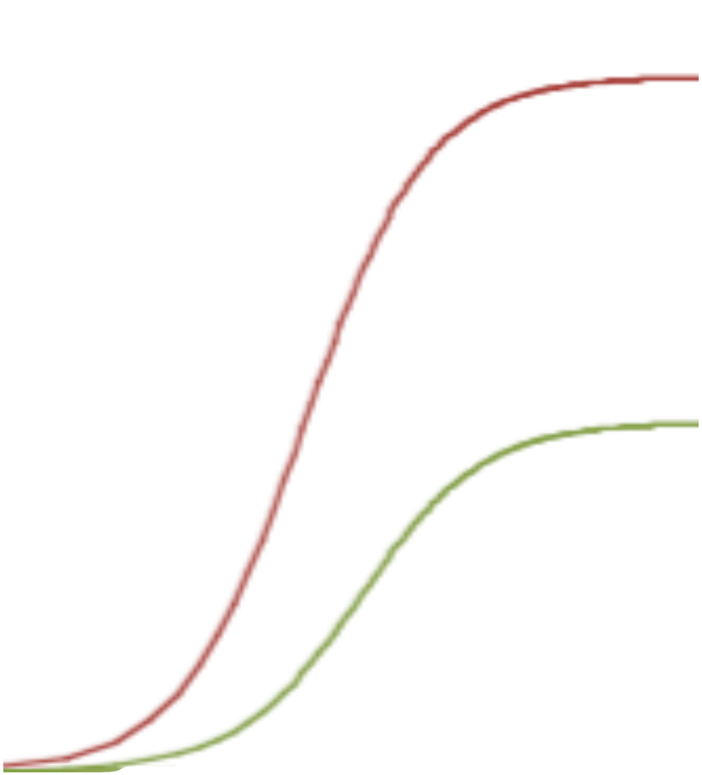
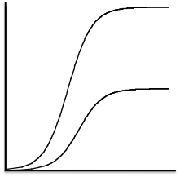
Myofilament Length Dependent Activation (LDA) underlies the Frank-Starling’s Law of the Heart
VENTRICLE
Ventricular Pressure
SARCOMERE
Force Development
long SL
Ventricular Volume
short SL
Activator [Ca²⁺]

Slide 42
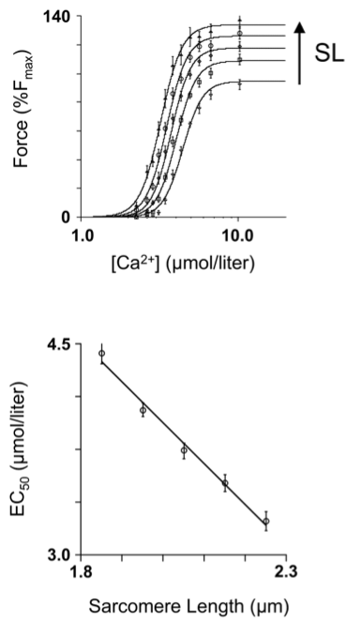
Myofilament Length Dependent Activation
Long SL increases sensitivity to calcium
Dobesh et al, AJP 2002

Slide 43
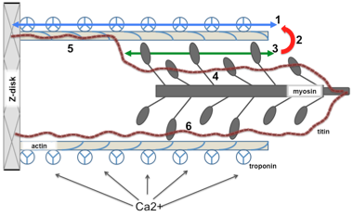
How is the information concerning muscle length transmitted to the myofilaments?

Slide 44
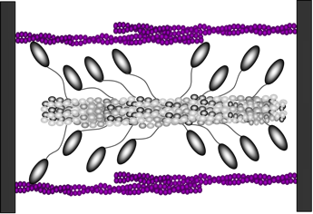
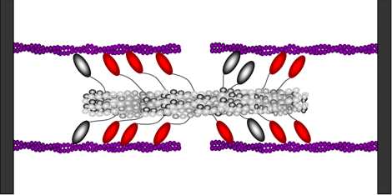
Lattice Spacing Hypothesis
SHORT SL
LONG SL
Original idea:
Alterations in inter-filament spacing with changes in length underlie the increase in Ca²⁺-sensitivity with increases in length
Lattice Spacing Hypothesis now debunked – cannot explain all changes in calcium sensitivity in terms of changes in lattice spacing
de Tombe PP, et al, 2010 J Mol Cell Cardiol. 48(5):851-8.

Slide 45
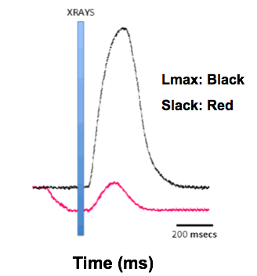
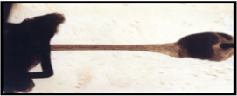
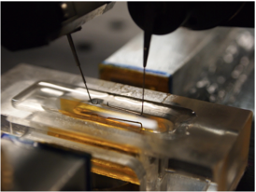
Two Dimensional X-ray Diffraction:
Sarcomere structure of Intact Twitching Cardiac Muscle

Slide 46
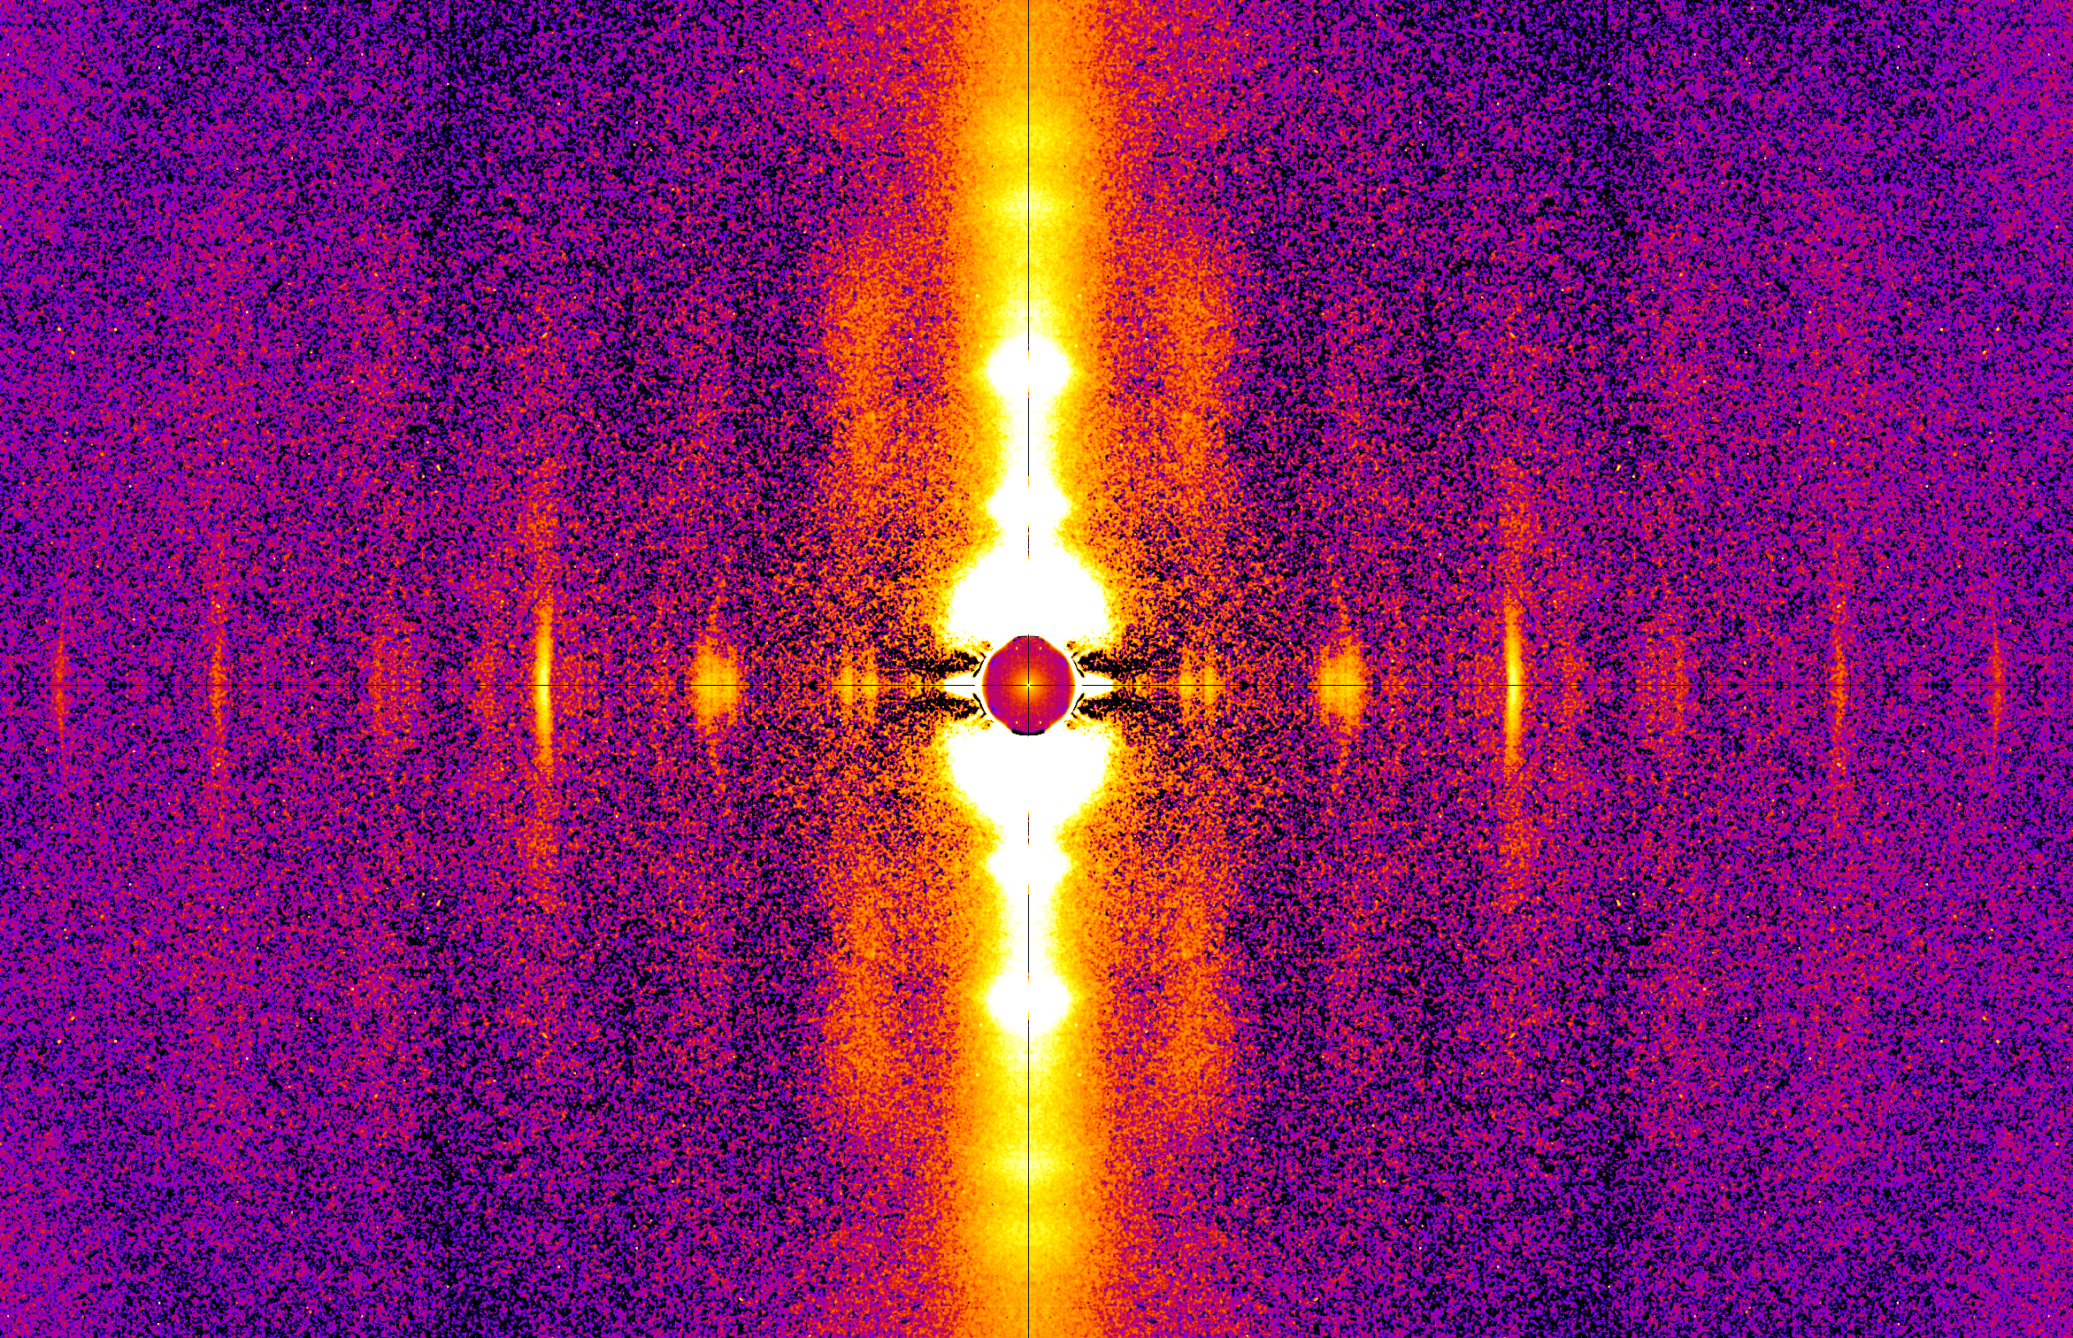
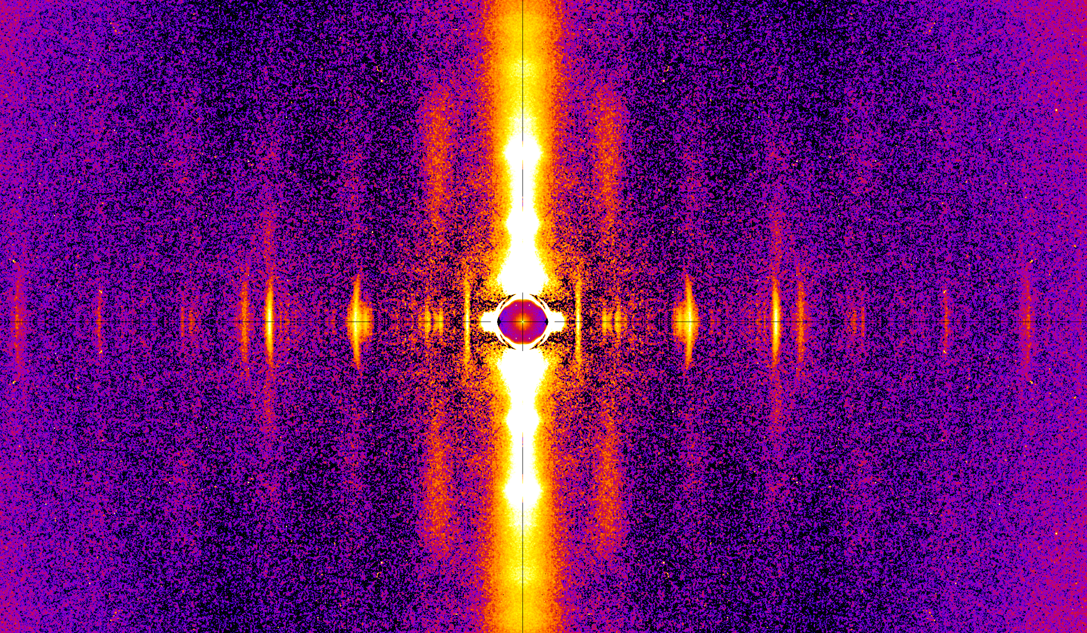
X-ray diffraction patterns from intact rat papillary muscle at slack and Lmax
Slack
Lmax
Hypothesis: Increased calcium sensitivity is due to an outward movement of myosin heads with stretch

Slide 47
Intensity of Equatorial Reflections as a Measure of Crossbridge Position
When crossbridges reach out and bind to actin there is an increase in the equatorial intensity ratio I₁₁/I₁₀
Notes:
Changes in equatorial peak intensities upon activation . If we plot the intensity profiles of these reflections, we see just that in comparing resting to active muscle patterns. So on the right we see electron density patterns of resting muscle, with mass indicated by black spots and the unit cell defined by dotted lines. The big spots are myosin and the small spots are actin. In active muscle, the outline of the myosin spot becomes less well-defined and the actin spots increase in size dramatically. The intensity profiles of these patterns on the left clearly display the changes in the reflections, as the 1,0 intensity decreases and the 1,1 intensity increases.

Slide 48
Our Hypothesis Predicts an Increase in I₁₁/I₁₀ At Longer SL
But a decrease is observed!
Heads appear to more associated with the thick filament backbone at long SL rather than with the thin filament
Farman et al. Am J Physiol Heart Circ Physiol. 201;300(6):H2155-60

Slide 49
Layer Lines Allow Direct Measurement Radius of Heads
First myosin layer line (M1)
Position of maxima on layer lines inversely proportional to radius to the center of mass of myosin heads

Slide 50
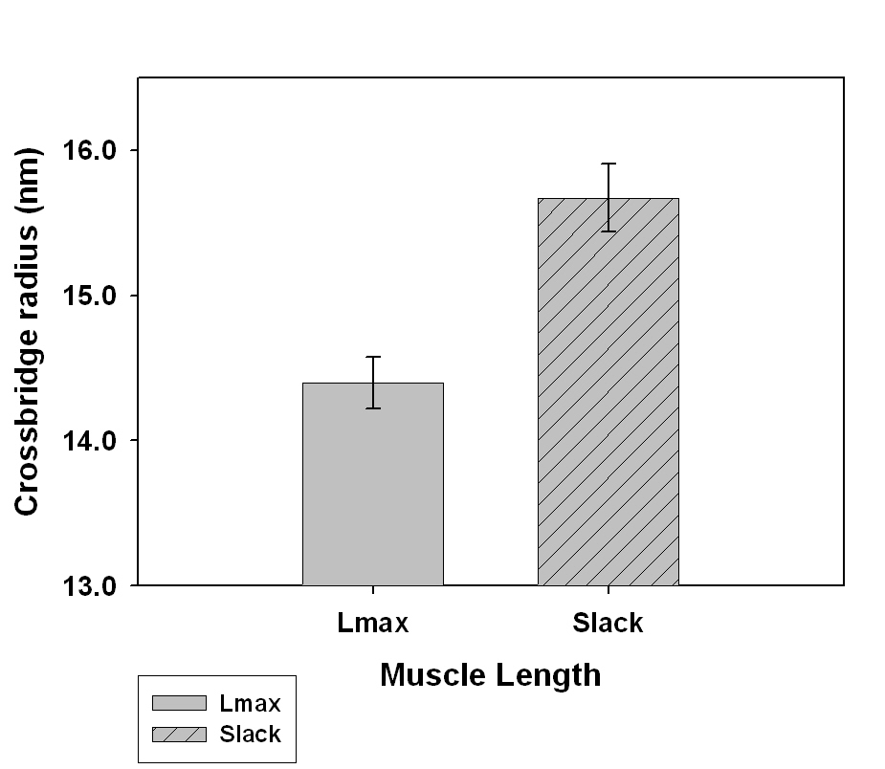
Myosin layer lines show inward radial motion of myosin heads with stretch
Slack
Lmax
Results show an inward movement of the myosin heads at long length consistent with I₁₁/I₁₀

Slide 51
M3 reflection is a Measure of Orientation of Myosin Heads
M3
M3
M3 reflection intensity is a sensitive measure of myosin head orientation
Strongest when heads are perpendicular to thick filament backbone
M3 intensity in diastole well correlated with maximum systolic force (Farman et al 2011 AJPH 300:H2155)

Slide 52
Conclusions
Myosin heads are closer to the thick filament backbone at long SL than short SL
Myosin heads are more perpendicular to the thick filament backbone at long SL than at short SL- better aligned with target zones on the thin filament?
  This tendency correlated with increases in calcium sensitivity
Still have not identified a length sensor – What else is going on in the 2D patterns?

Slide 53
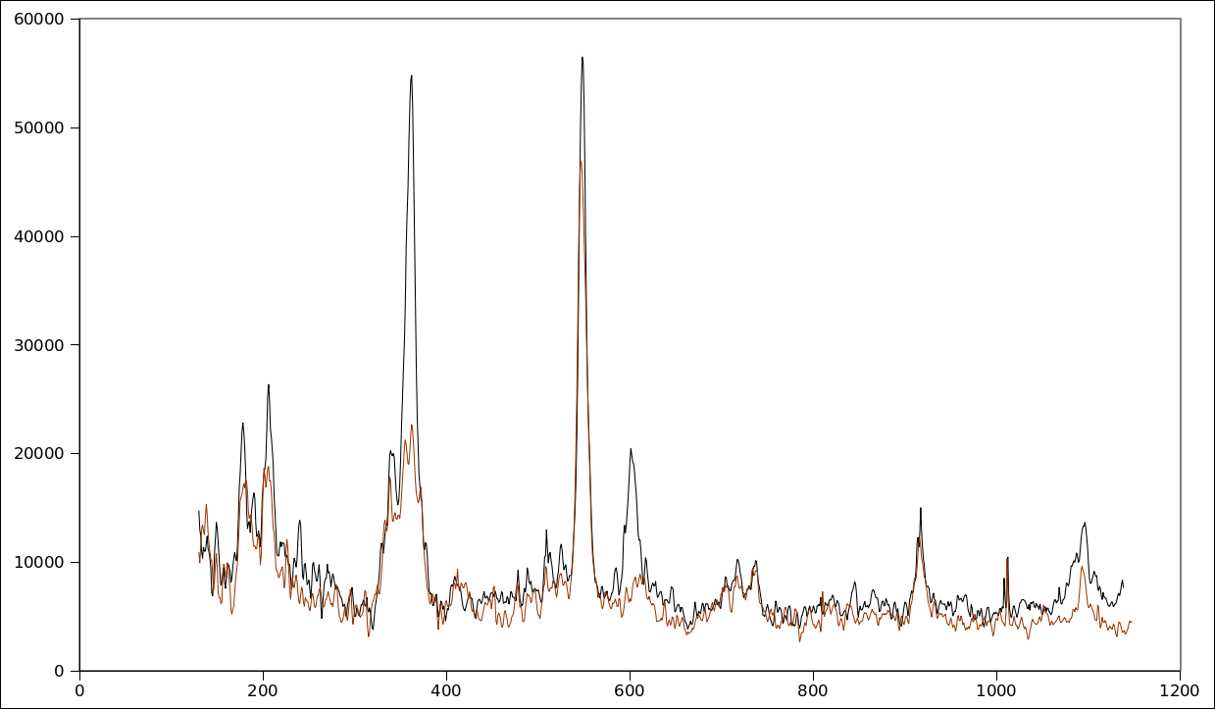
M2
M3
Slack (Red)
Lmax (Black)
T3
M6
Meridian of pattern gives information from structures along axes of filaments M2, M3,M6 -myosin, T3-troponin

Slide 54
2nd order myosin reflection intensity
The m2 reflection is “forbidden” by helical symmetry
Must be a rearrangement of myosin heads between helically ordered and distorted regions on the surface of the thick filament (Malinchik & Lednev, 1992) so that more distortion at longer lengths
Head arrangement is different at longer SL!
Stretch : increased M2 intensity (~2.8 fold; p < 0.05)

Slide 55
3rd order troponin reflection intensity
Changes in the T3 reflection suggest changes in the orientation and position of the troponin complex when the thin filament is stretched similar to that seen when muscles contract (Maéda et al., 1992)
Stretch : Increased T3 intensity (~1.9 fold; p < 0.05)

Slide 56
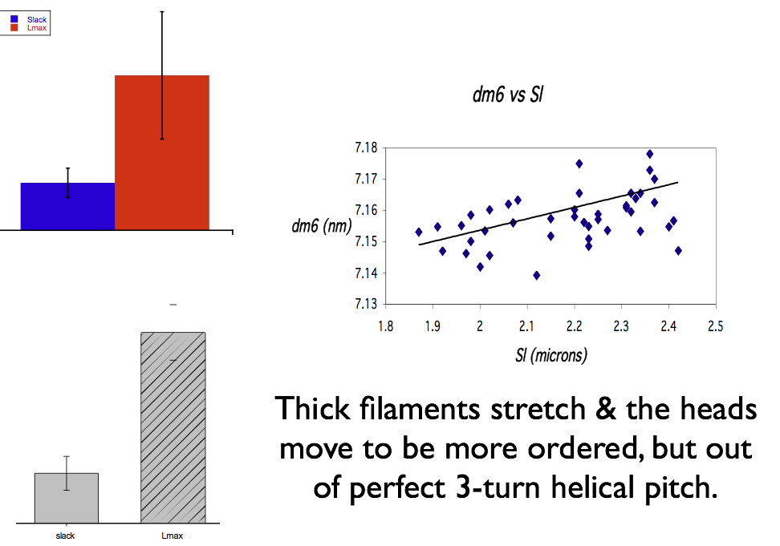
Strain in the Thick Filament May be the Length Sensor
The intensity of the m6 meridional reflection dominated by structures
In thick filament backbone
Thick filaments extend slightly (up to 0.3%) when sarcomeres stretched to longer lengths

Slide 57
Titin Based Passive Tension as the Source of Thick Filament Strain
Z-line
thin filament
Thick filament
Sarcomere stretch
F
F_{r} (F times sinα)
α
F_{l} (F times cosα)

Slide 58
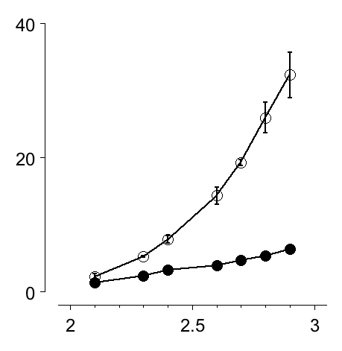

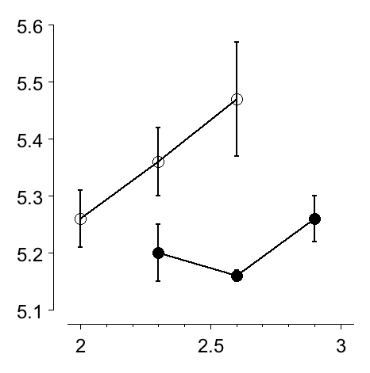
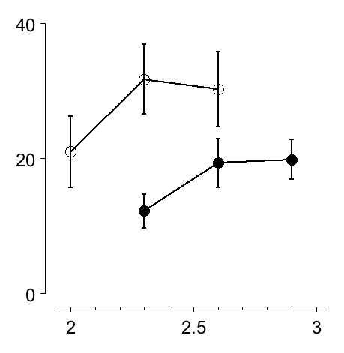
Testing the titin-based tension hypothesis:
passive F (mN/mm²)
Use N2BA-G mutant rats with longer isoform of titin than WT
Much less passive force
No LDA
Much less peak active force
pCa₅₀
active F (mN/mm²)
Greaser et al., J Mol Cell Cardiol. 44(6):983-91 2008
SL (µm)

Slide 59
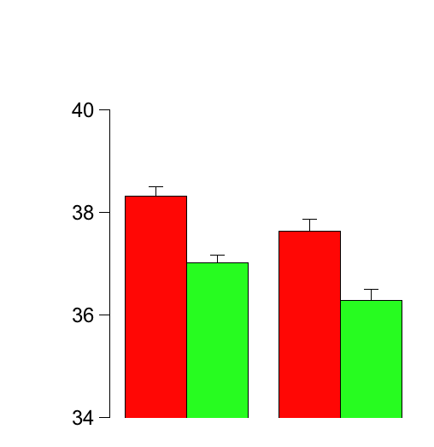
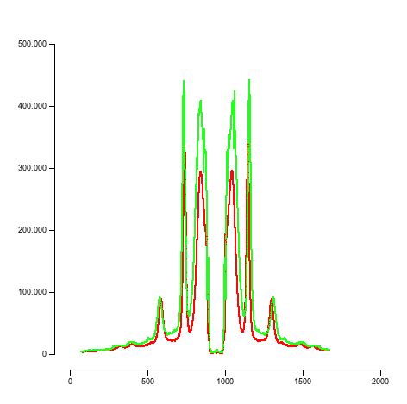
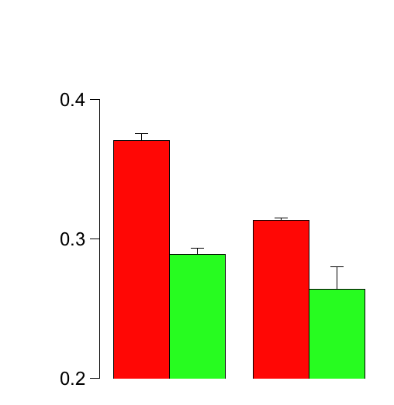
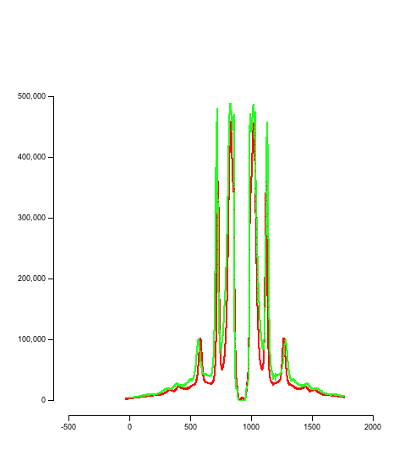
Wild-Type
Wild-Type
mutant
1,0
Lattice spacing (nm)
1,1
N2BA-G mutant
I_{1,1} / I_{1,0} Ratio
short
long
short
long

Slide 60


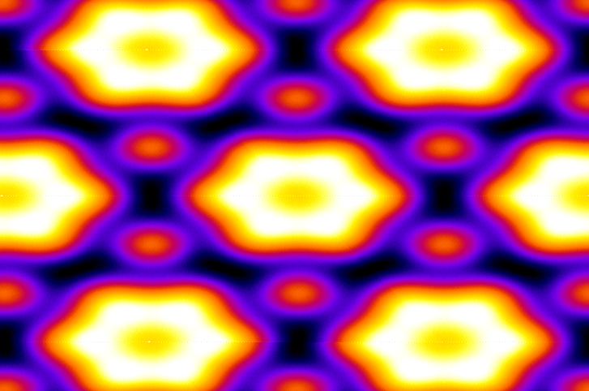


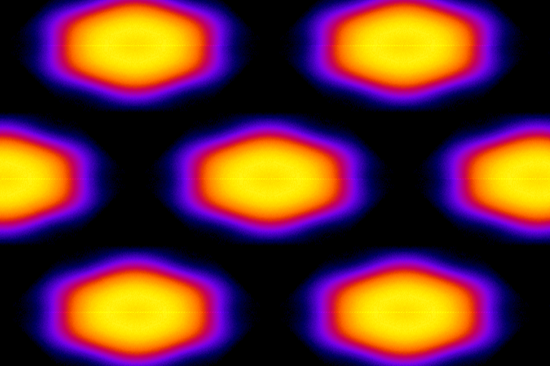
Slack
Lmax
Difference
WT
WT
HM
M
M
A
M

Slide 61


M₃
Wild-Type
M₂
M2
Tn3
Tn₃
M₅
M₆
M₄
Titin
mutant
M2
Tn3
M2 and Tn3 intensity changes seen in WT much reduced in mutant myocardium

Slide 62
Conclusions
Changes in muscle length induce structural changes in both the thick filament and the troponin complex on the thin filaments.
Changes in the troponin complex structure in diastole could be the key part that underlies the molecular mechanism underlying length modulation of myofilament Ca²⁺ sensitivity.
Structural changes in the thick filament may modulate this mechanism

Slide 63
Conclusions
Our results show that there must be communication between the thick and the thin filaments
There are significant numbers of bound crossbridges in cardiac muscle in diastole
Thick filaments are under strain due to titin-based passive tension when slack muscle is stretched

Slide 64
Conclusions
Strain may be transmitted via crossbridges to the thin filaments
Strain in crossbridges somehow induces changes in the troponin complex
This may be the key step in length dependent activation

Slide 66

Time-resolved X-ray Diffraction Studies of Drosophila Indirect Flight Muscle in vivo
Michael Dickinson
Mark Frye
(Caltech)
David Maughan (UVM)
Tom Irving (BioCAT/IIT)

Slide 67

Important periodicities
Tn
38.7 nm
19.3 nm
Target Site
d
14.5 nm
7.2 nm
56 nm
Lengthening
Shortening

Slide 68

Dickinson et al., 2005 Nature 433:330-4

Slide 69

7.2 nm myosin periodicity
(thick filament length)
0.25
During each wingbeat a significant amount of strain energy is stored in stretching and releasing the thick filaments in the flight muscles
lengthen
shorten
lengthen
shorten
0
% spacing change
-0.25
upstroke
downstroke
upstroke
downstroke
0.0
0.5
1.0
1.5
2.0
wing beat phase
Dickinson et al.,2005 Nature;433:330-4
Two cycles of “movie”. Time between successive points ~ 600 µs

Slide 70

19.3 nm first row line spot intensity
(crossbridge attachment)
Crossbridges are recruited to actin binding sites while the flight muscle is being stretched.
During the downstroke, force producing crossbridges cycle and then detach abruptly
Suggests strain dependent mechanisms for both crossbridge recruitment and detachment
600
lengthen
shorten
lengthen
shorten
500
400
% intensity change
300
200
100
0
upstroke
downstroke
upstroke
downstroke
0.0
0.5
1.0
1.5
2.0
wing beat phase
Two cycles of “movie”. Time between successive points ~ 600 µs
Dickinson et al.,2005 Nature;433:330-4

Slide 71

X-ray diffraction evidence for tropomyosin movement during stretch activation of insect flight muscle
Robert J. Perz-Edwards, Thomas C. Irving, Bruce A. J. Baumann, David Gore, Daniel C. Hutchinson, Uroš Kržič, Rebecca L. Porter, Andrew B. Ward, Michael K. Reedy. “X-ray diffraction evidence for myosin-troponin connections and tropomyosin movement during stretch activation of insect flight muscle" PNAS, 108:120-5. 2011

Slide 72

X-ray Movies During Oscillatory Contraction
Visualization of Troponin/Tropomyosin system during oscillatory contraction of Insect Flight Muscle
Perz-Edwards et al., 2011 PNAS 108:120-5

Slide 73

Active
Relaxed

Slide 74

INTENSITY of TROPOMYOSIN Layer Line
Str-ACT shows strong single peak; leading edge ahead of NET force rise.
NET
Str-ACT Force
PHASING
TROPOMYOSIN Layer Line
Notes:
74

Slide 75

Stretch Activation Works by the Familiar “Steric Blocking” Mechanism
In vertebrate striated muscle, high calcium binds troponin causing azimuthal shift of tropomyosin, exposing the myosin binding sites on actin
Difference in stretch activation is that mechanical strain delivered by a small number of bound crossbridges, perhaps special “troponin bridges” allows tropomyosin to move
.

Slide 77
Equatorial Intensities
If crossbridges move away from the thick filament backbone towards the thin filament
Mass leaves the 1,0 plane and joins 2,0
I_{2,0}/I_{1,0} goes up

Slide 78
Equatorial Intensities
UseI_{2,0}/I_{1,0} as a measure of degree of association crossbridges with thin filament
In vertebrate muscle use I_{1,1}/I_{1,0} instead

